Slide 1
Hormones, trans populations, and metabolic consequences
Emilia M. Jalil
National Institute of Infectious Diseases Evandro Chagas – FIOCRUZ
Rio de Janeiro, Brazil
Metabolic consequences of new classes of ART
Notes:
Thanks for inviting me to present today.

Slide 2
Conflict of interest disclosure
Nothing to disclose.
Notes:
I have nothing to disclose.

Slide 3
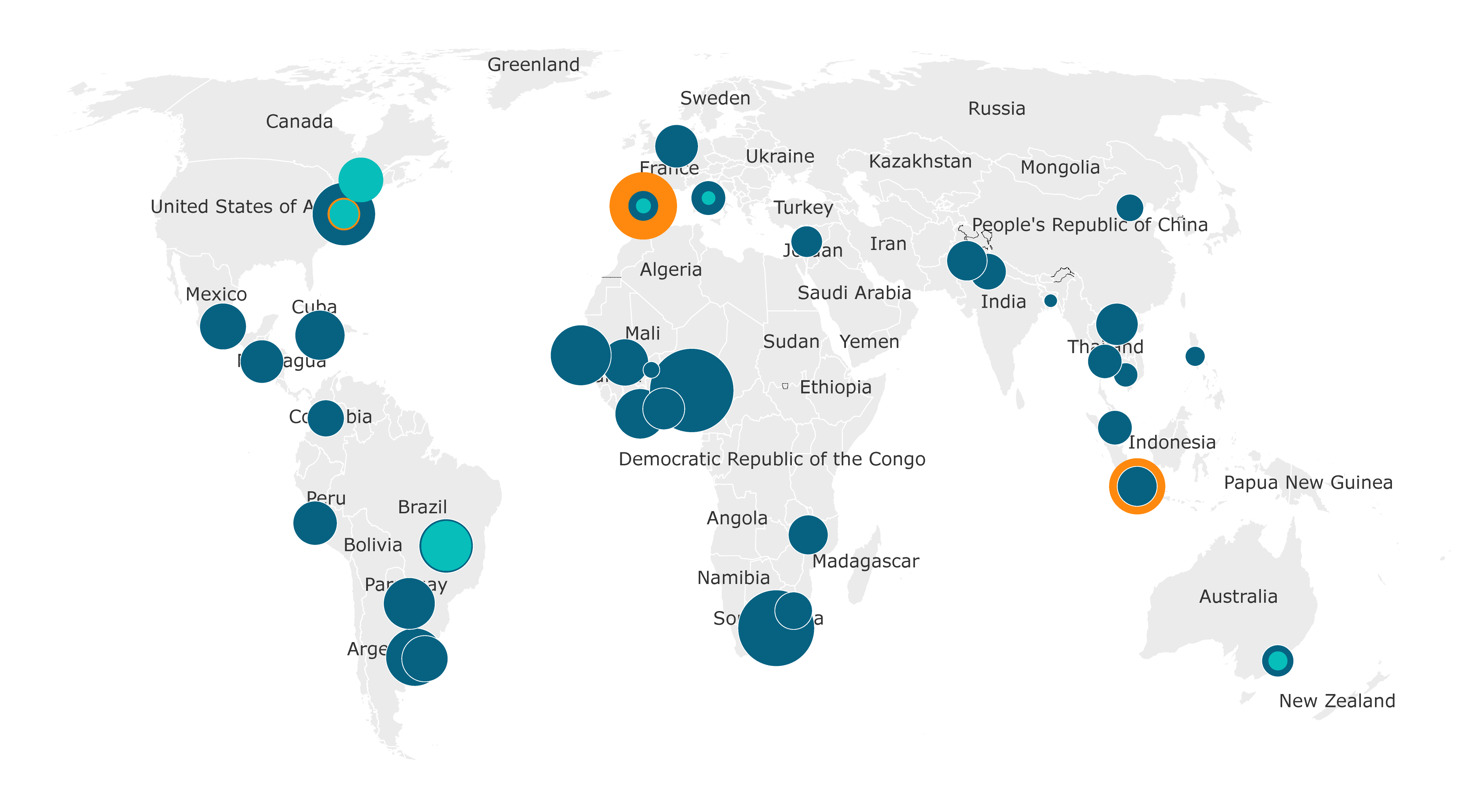
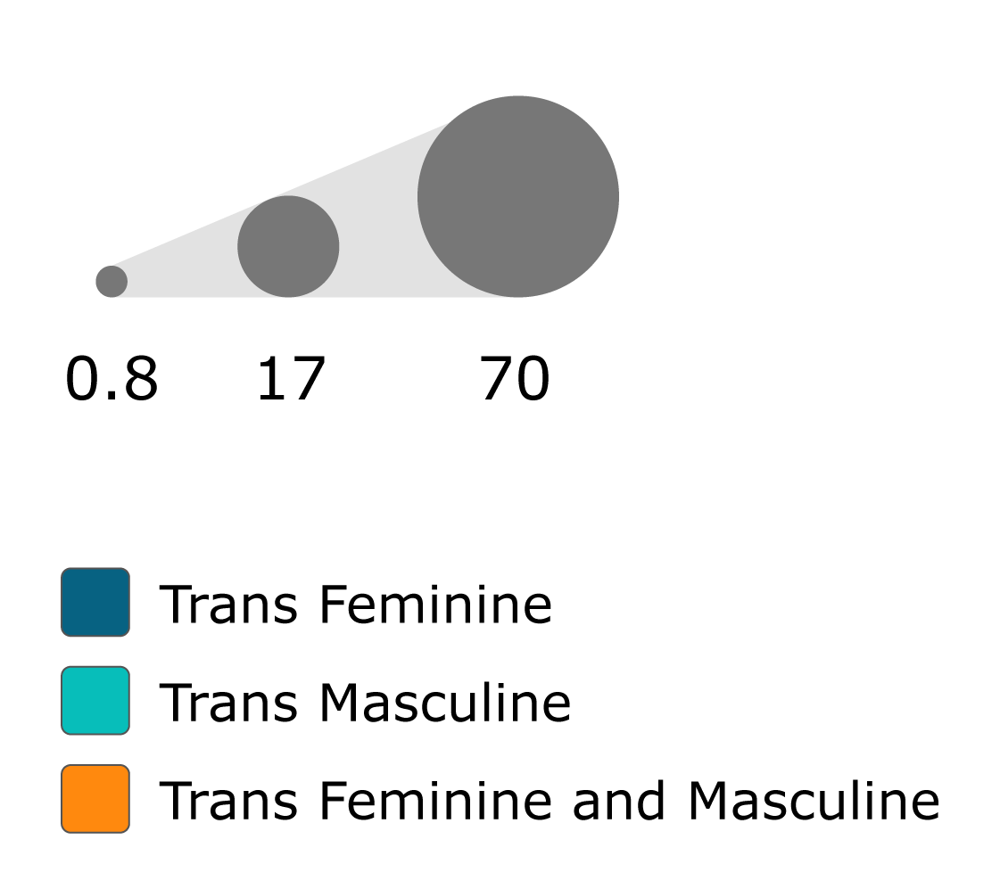
Worldwide HIV prevalence among transgender individuals
Adapted from: Stutterheim et al 2021.
Notes:
Transgender individuals, defined as individuals whose sex assigned at birth is different than their gender identity or whose gender identity is incongruent with gender norms, have a disproportionate burden of HIV worldwide and thus are considered a priority population for HIV prevention and care.
The high vulnerability of HIV is present not only among trans women but also among trans men who have sex with men.

Slide 4
Hormone therapy among trans individuals
PERSON
TRANSITION-RELATED CARE
BASIC MEDICAL CARE
NON-MEDICAL TRANSITION
MEDICAL TRANSITION
LEGAL
PSYCHOSOCIAL
HORMONETHERAPY
SURGERY
Adapted from: https://www.rainbowhealthontario.ca/TransHealthGuide/index.html#intro
Notes:
Transitioning is not a linear process, and each person may have different pathways and goals.
Many trans people will seek medical assistance in order to bring their physical appearance in line with their gender identity. This could include hormone therapy.
Gender-affirming hormones are used by approximately half of trans and gender-diverse people, although a higher percentage (almost 80%) are interested in accessing this care in their lifetime

Slide 5
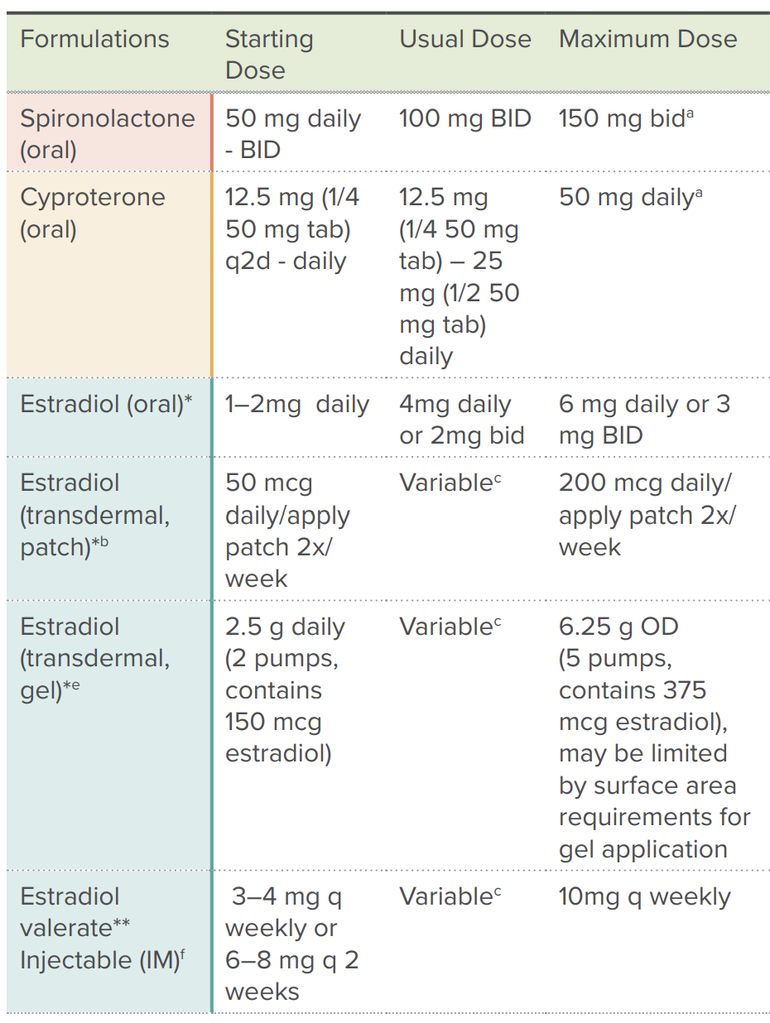
Feminizing HT
ANTI-ANDROGEN
plus
ESTROGEN
https://www.rainbowhealthontario.ca/TransHealthGuide/pdf/QRG_femHT_2021.pdf
Notes:
The goal of hormone therapy in transfeminine patients is to reduce the endogenous effects of testosterone and to induce feminine secondary sex characteristics. This requires a suppression of endogenous androgens and the addition of estrogen, so usually the feminizing hormone therapy combines an anti-androgen agent to one estrogen.
The box presents the most common formulations and recommended doses of hormones used for feminization.

Slide 6
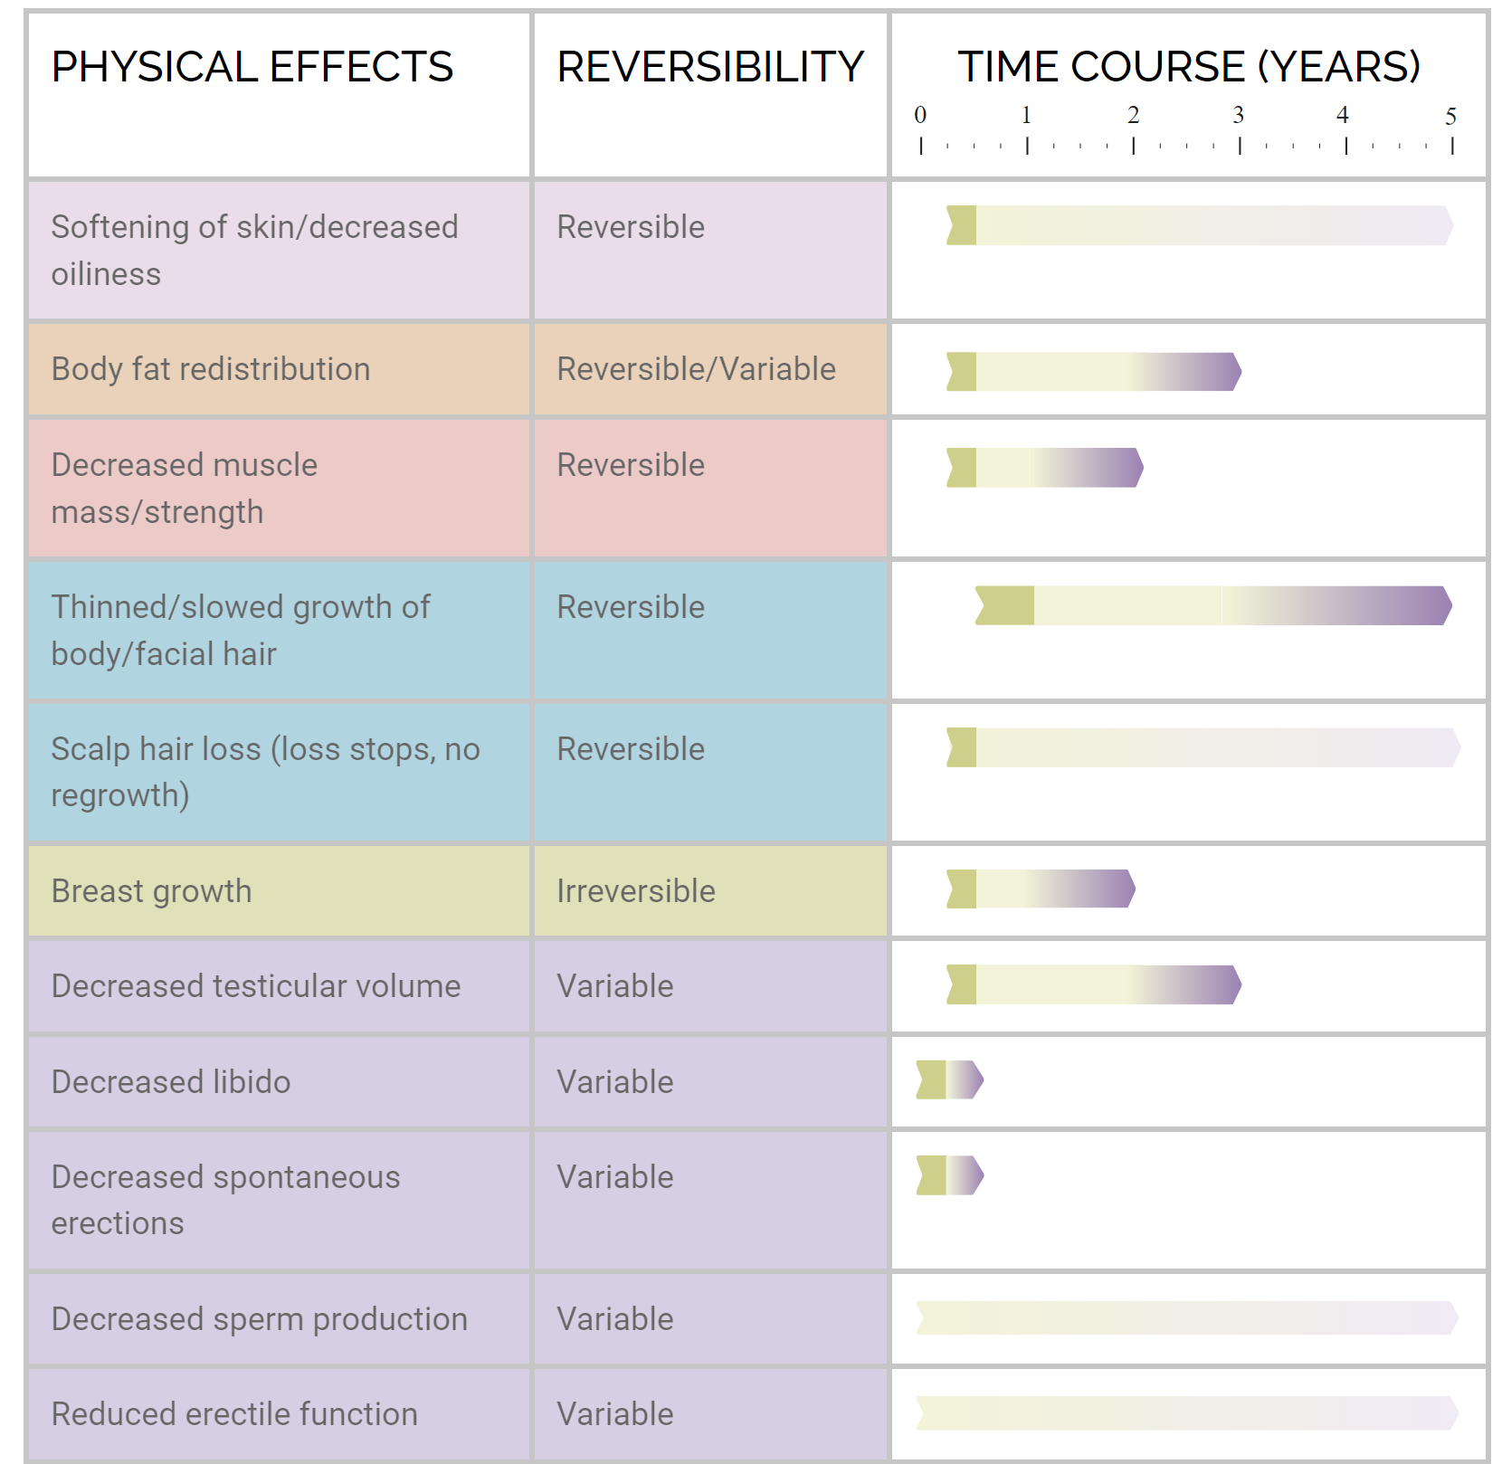
Feminizing HT
https://www.rainbowhealthontario.ca/TransHealthGuide/gp-femht.html
Notes:
The degree and rate of physical effects of the hormone therapy are largely dependent on patient-specific factors such as age, genetics, body habitus and lifestyle, and to some extent the dose and route used.
Physical changes related to androgen blockade and estrogen may take months to appear and are generally considered to be complete after 2-3 years on hormone therapy.

Slide 7
Feminizing HT
Decreased muscle mass/strength
Body fat redistribution
Fat redistributes from abdomen and mid-section regions to the buttocks, hips and thighs.
Favourable changes in lipid profile
Variable effect on bone density
https://www.rainbowhealthontario.ca/TransHealthGuide/gp-femht.html
Notes:
The feminizing hormone therapy is associated with:
Decreased muscle mass and strength
Body fat redistribution from abdomen and mid-section to the buttocks, hips and thighs.
Data on changes in lipid profile are inconsistent but in general lipid profile is favorably changed in trans women.
Also, the feminizing hormone therapy has variable effect on bone density.

Slide 8
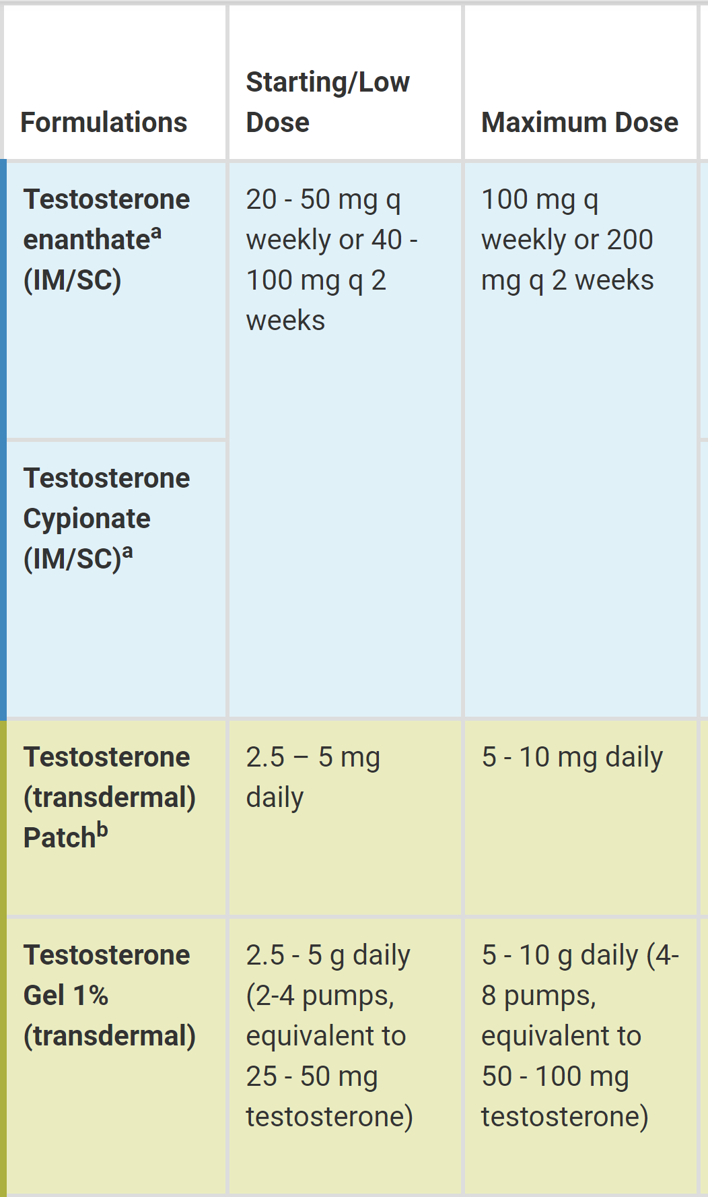
Masculinizing HT
TESTOSTERONE
https://www.rainbowhealthontario.ca/TransHealthGuide/
Notes:
The cornerstone of hormone therapy for trans men is testosterone aiming to develop masculine secondary sexual characteristics.
Injectable formulations are most commonly used, due to their superior efficacy and affordability.

Slide 9
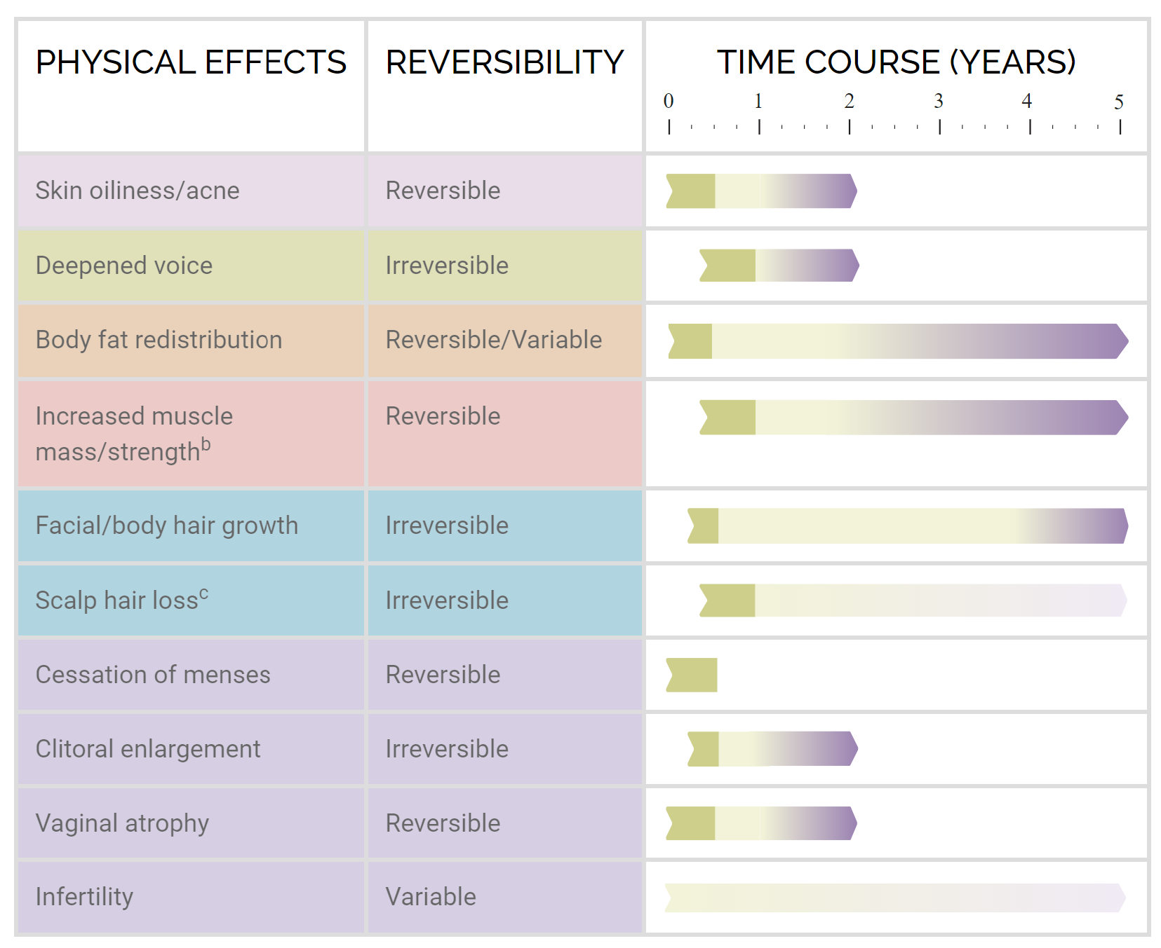
Masculinizing cross-sex HT
https://www.rainbowhealthontario.ca/TransHealthGuide/gp-mascht.html
Notes:
Typically, patients taking testosterone will experience masculinizing changes over a period of months to years.

Slide 10
Masculinizing cross-sex HT
Increased muscle mass/strength
Body fat redistribution
Fat redistributes from buttock, hip and thighs to the abdomen and mid-section.
Increase total cholesterol, LDL and TG, decrease HDL
Increase in bone density
https://www.rainbowhealthontario.ca/TransHealthGuide/gp-mascht.html
Notes:
Masculinizing hormone therapy is associated with:
Increased muscle mass and strength
Body fat redistribution from buttock, hip and thighs to the abdomen and mid-section
Increased total cholesterol, LDL and triglicerydes, as well as decreased HDL
And increase in bone density

Slide 11
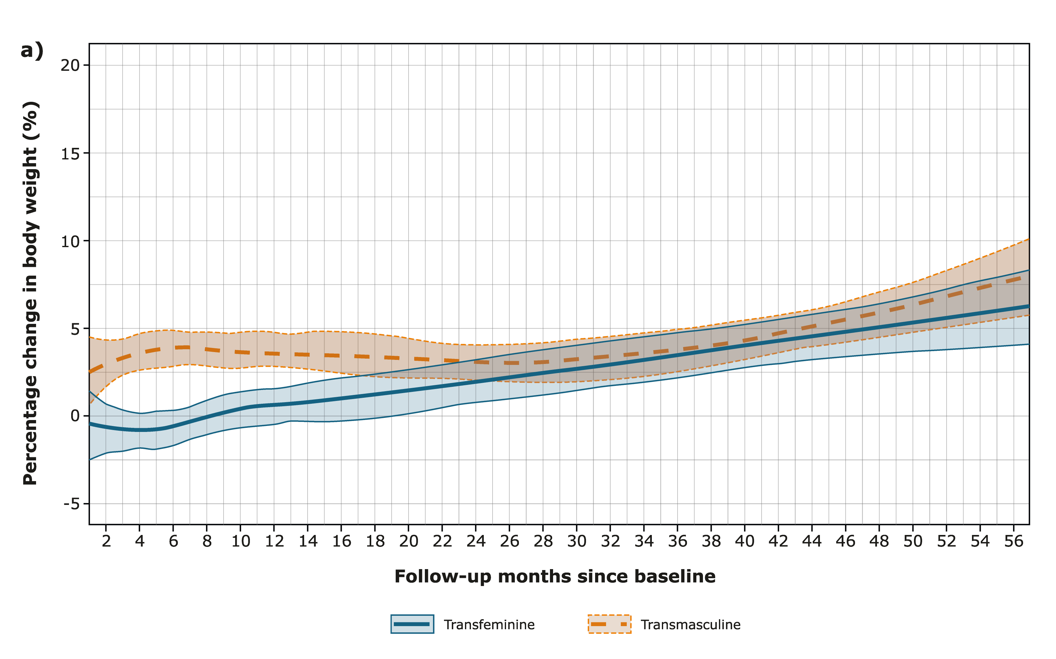
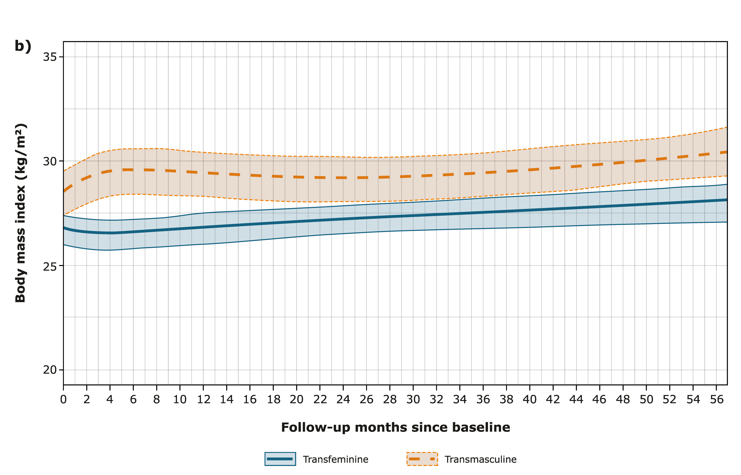
Weight gain during hormonal therapy
Kyinn et al 2021.
Notes:
Hormone therapy increases body weight in both gender identities.
In a longitudinal study of 470 individuals in the US, treatment with gender-affirming hormone therapy was associated with an increase in mean body weight within 2–4 months among trans men and after 22 months among trans women.
As compared with transfeminine individuals, transmasculine individuals have greater rates of obesity and weight gain before and during hormone therapy.

Slide 12
Concomitant use of HT and ARVs
HT
ARV
Notes:
And what to expect in a context of hormone therapy and ARV concomitant use, especially the new ARVs?

Slide 13
Concomitant use of HT and ARVs
Concerns with concomitant use of HT & ARV
Potential drug-drug interactions
Efficacy
Adverse effects
Health providers tend to suboptimal approach due to these concerns
Trans people do not use their medication as recommended due to these concerns
HT
ARV
Notes:
The concomitant use of hormone therapy and ARVs raises some concerns such as potential drug drug interactions, impact on efficacy, and increases adverse effects.
Due to those concerns, health providers tend to have suboptimal approaches among trans clients.
On the Other hand, trans individuals may not use their medication as recommended, which ultimately impacts on adherence.

Slide 14
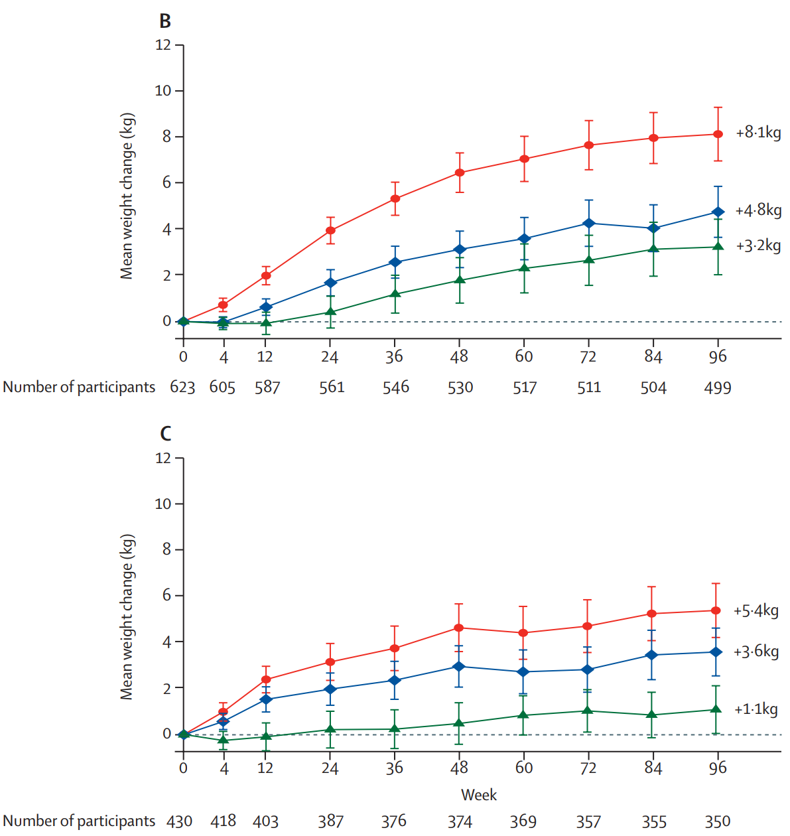
Weight gain and gender among PLWHIV
Advance study
DTG+FTC+TDF or TAF vs. EFV+FTC+TDF
N=1,053 participants
59% female
Venter et al 2020.
Notes:
Among people living with HIV, the discussion on weight gain and gender gained momentum with the ADVANCE study, a randomised, open-label, non-inferiority phase 3 trial conducted in South Africa to compare the efficacy and safety of three ARV combinations. The study results identified that weight gain was more pronounced among females regardless of the ART regimen.

Slide 15

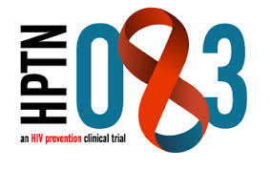
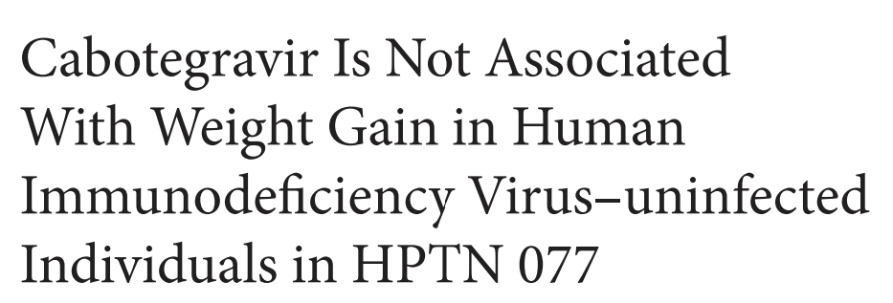
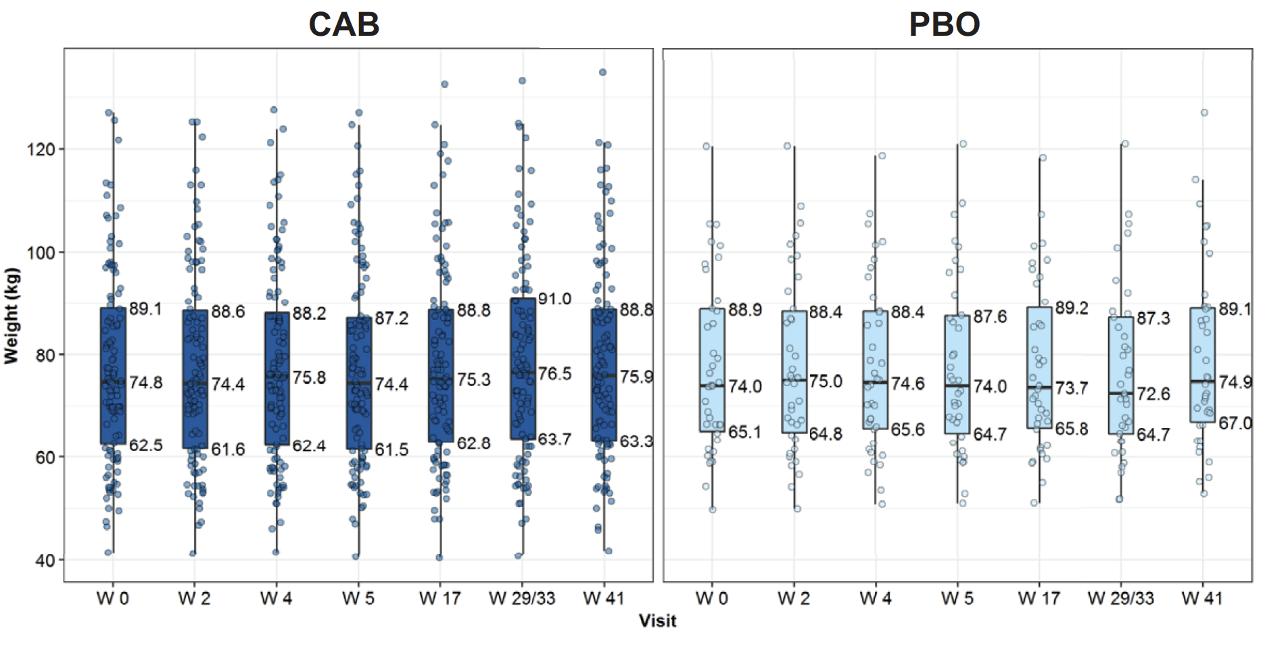
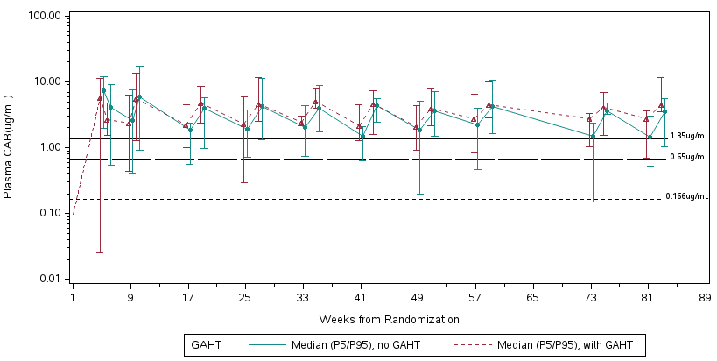
LA CAB and feminizing HT
TGW in HPTN 083: An Evaluation of Safety, Efficacy, and Gender Affirming Hormonal Therapy (GAHT) Interactions with LA Cabotegravir
Landovitz et al 2020; Grinsztejn et al 2022.
Notes:
Among low risk, HIV-negative individuals, HPTN 077, a randomized, double-blind placebo-controlled phase 2a trial conducted at 8 sites in Brazil, Malawi, South Africa, and the US, identified no association between cabotegravir and weight gain among 200 individuals, including trans participants.
In this conference, we present HPTN 083 data specifically on trans women. With the largest enrollment number of trans women ever enrolled in a PrEP clinical trial, HPTN 083 represents a great opportunity to evaluate the interactions between weight and the concomitant use of LA cabotegravir and hormones.

Slide 16
Important research gaps and challenges
Observational, non-controlled studies
Lack of trans-specific data or analysis
Access to the population
Medical mistrust by trans communities
Safer 2021.
Notes:
Despite the need to inform trans-specific HIV prevention and care, rigorous medical intervention outcomes studies among transgender people remain rare. Most published research includes cross-sectional studies and small single-site cohort studies.
There is a lack of trans-specific studies or disaggregated analysis.
Usually, trans people are considered a hard to reach and engage population, especially due to the lack of surveillance efforts including trans populations. In addition, prior negative experiences in healthcare settings lead to avoidance of health care and medical mistrust.
The limitations of current data may not refrain clinicians from providing hormone therapy to trans individuals concomitantly to PrEP or ART.

Slide 17

Thanks very much!
Emilia M. Jalil
emilia.jalil@ini.fiocruz.br
Notes:
Thanks very much

