Slide 1
Integrated Trans-Competent Care for Trans People Symposium: In it together: How to integrate health services for specific populations
Rena Janamnuaysook
Institute of HIV Research and Innovation, Thailand
30 July 2022

Slide 2
Conflict of Interest Disclosure
Gilead Sciences: Research funding
ViiV Healthcare: Speaker fees
MSD: Community Advisory Board
The potential effects of relevant financial relationships with ineligible companies have been mitigated. Any clinical recommendations are based on evidence and are free of commercial bias.

Slide 3
Outlines
Population size estimation, HIV situations among transgender people in Thailand
The Tangerine Clinic as an integrated transgender-competent care model
Outcomes and impacts
Conclusions

Slide 4
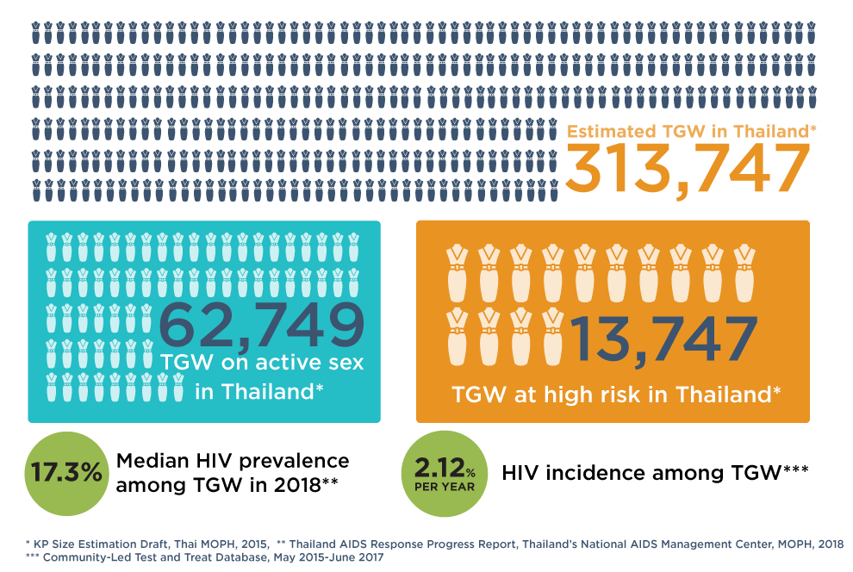
Transgender Women in Thailand: Population Size Estimation and HIV

Slide 5
Stigma and discrimination in healthcare settings
1
2
3
Sources:
*Thai Transgender Alliance and Transgender Europe, 2015
** Report of a pilot: Developing Tools and Methods to Measure HIV-related Stigma and Discrimination in Health Care Settings in Thailand and;
the HIV Stigma and Discrimination Survey Guidelines and Procedures Manual, International Health Policy Program, National AIDS Management Center (NAMC) Thailand,
Ministry of Public Health (November 2014).e

Slide 7
Service package

Slide 8
Service package

Slide 9
Service Data: Transgender Women

Slide 10
Demographics of Transgender Woman Clients

Slide 11
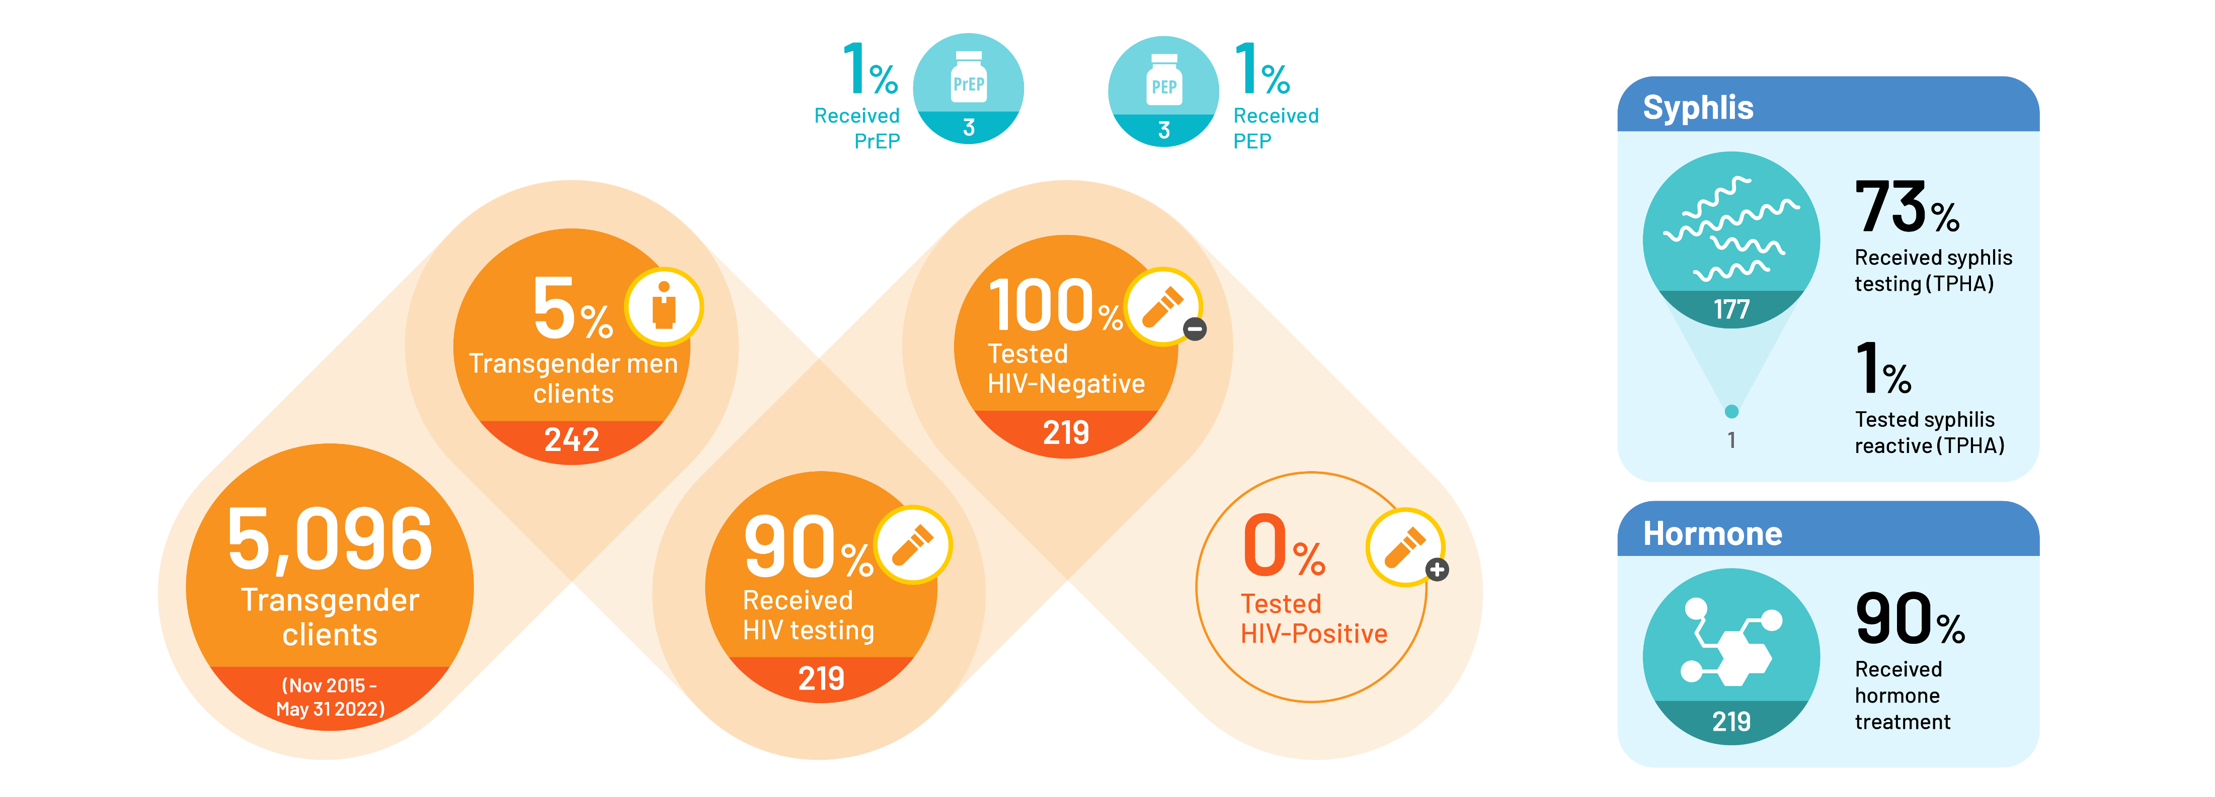
Service Data: Transgender Men

Slide 12
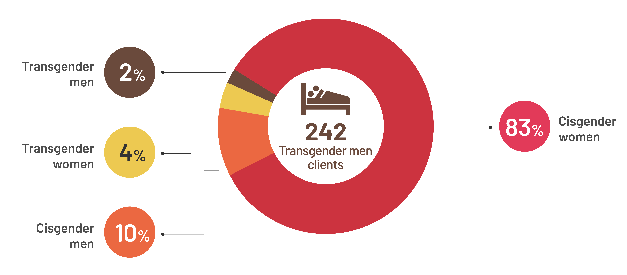
Sexual Behaviors: Transgender Men

Slide 13
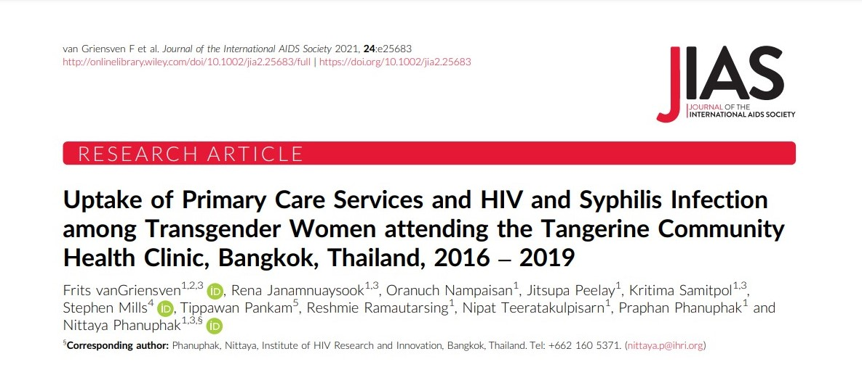
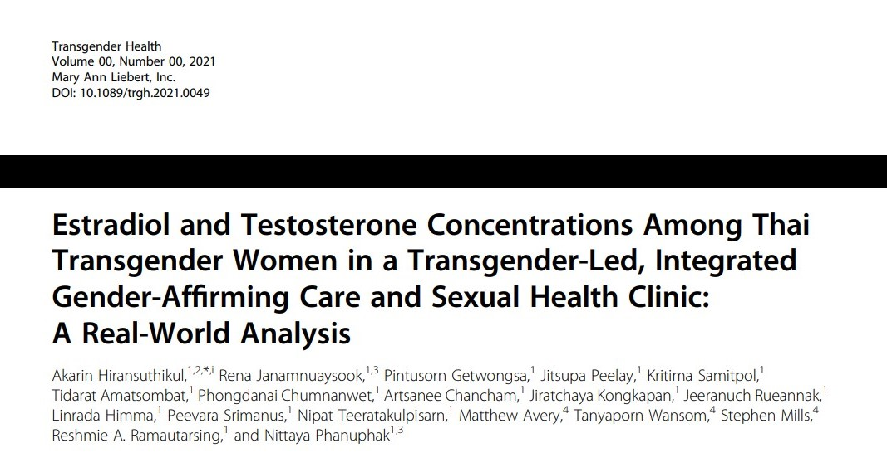
From Program Implementation to Population Impacts
The increasing uptake of a transgender-specific package of services, including co-located gender affirming hormone therapy, suggests this may be an effective model in engaging and retaining transgender women in primary care.
Only one-third of Thai transgender women who were using feminizing hormone treatment had any hormones within target concentrations at baseline in this real-world setting study.
More than half managed to achieve or maintain at least one hormone concentration within target concentrations at follow-up visits, suggesting a positive effect from attending a trans-led, integrated gender-affirming care and sexual health services.

Slide 14
Mental Health Matters: Peer-led depression screening (Oct 21-Mar 22)
PHQ-2: Patient Health Questionnaire-2, PHQ-9: Patient Health Questionnaire-9, PrEP: Pre-exposure prophylaxis
Janamnuaysook R, et al., Oral Abstract Presentation, OAF0204, AIDS 2022, Canada.
Notes:
หาที่ใส่โลโก้ CHIMERA Project ให้หน่อยค่ะ

Slide 15
Comprehensive Service Package

Slide 16
Comprehensive Service Package

Slide 17
Asia Regional USAID Key Population Investment Funds: Expanding Integrated Transgender Competent Care
Notes:
รบกวนช่วยเติม Victoria by LoveYourself เหนือ Lakan ให้ด้วยนะคะ

Slide 18
Conclusions
Integrated gender-affirming care and trans-competent providers increase access to HIV and other sexual health services among transgender people.
People-centered health services must be adopted and organized around the health needs of people rather than diseases.
Transgender-led and transgender-owned programming is key to the HIV community response and should be sustained.

Slide 19
Acknowledgements
Transgender Clients
Praphan Phanuphak
Nittaya Phanuphak
Panus Na Nakorn
Stephen Mills
Peevara Srimanus
Kritima Samitpol
Krittaporn Termvanich
Jakkrit Utayananon
IHRI/Tangerine Clinic Staff
Notes:
ใส่โลโก้ LoveYourself ให้ด้วยค่ะ

Slide 20
Rena.j@ihri.org
Notes:
อยากได้รูปนี้ใส่ลงไปค่ะ แต่เปลี่ยนคำก็ได้นะคะ เป็น Trans Health is Human Rights และฝากใส่เมลเราให้ด้วยค่ะ

