Slide 1
Lessons Learned from Community Engagement in HIV Phylogenetic Research
Diana M. Tordoff (she/her)
University of Washington, Department of Epidemiology
Big data and AI: An ethical and human rights-based HIV response?
Notes:
Thank you again to the symposium organizers for inviting me to speak. Today I’ll be sharing some lesson learned from community engagement on the use of MHS data in HIV Phylogenetics Research.
I have conflicts to disclose.

Slide 2
Conflict of interest disclosure
I have no relevant financial relationships with ineligible companies to disclose.

Slide 3
Overview of Talk
Overview of the original study aims/methods
Why we paused our HIV phylogenetics study to conduct community engagement
Lessons we learned through community engagement
Why we decided not to publish our findings
Notes:
Today I’ll provide a brief overview of an HIV phylogenetic study we were conducting at the University of Washington
I’ll talk about why we paused this study to conduct community engagement
The Lessons we learned through this process
And conclude with the reasons why we chose not to publish our study findings.

Slide 4
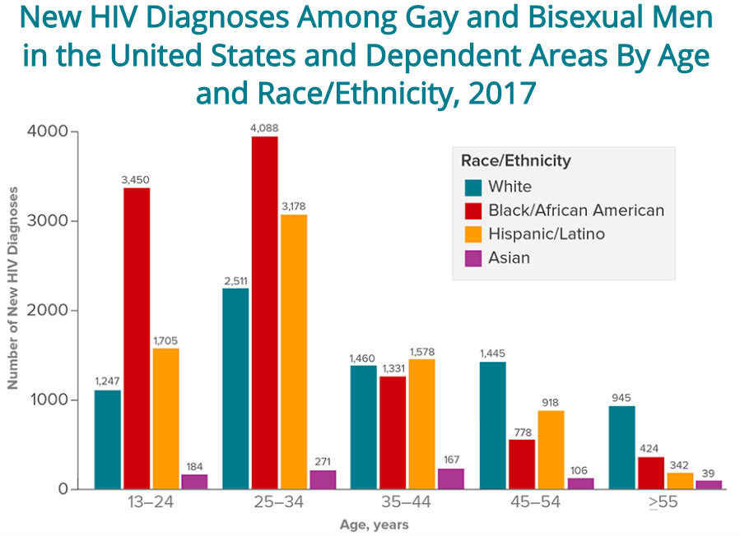
Original Study: What is the Role of Assortativity in Sustaining HIV Disparities?
Assortativity
“an increased likelihood of choosing sex partners from one’s identified subgroup”
Degree of assortativity can be quantified by analyzing HIV sequence data.
HIV Disparities
Assortative mixing by racial identity and disassortative mixing by age has been hypothesized to explain disparities in HIV incidence among gay, bisexual, and other men who have sex with men (MSM) in the US.
Notes:
Our original study was motivated by the potential role of assortativity in sustaining HIV disparities in the US
In this context, assortativity is the increased likelihood of choosing sex partners from your own identified subgroup.
And the degree of assortativity can be quantified using HIV sequence data.
In the US, there are significant disparities in HIV incidence among MSM by age, race, and ethnicity.
And Assortative mixing by race and disassortative mixing by age have been hypothesized to explain these disparities.

Slide 5
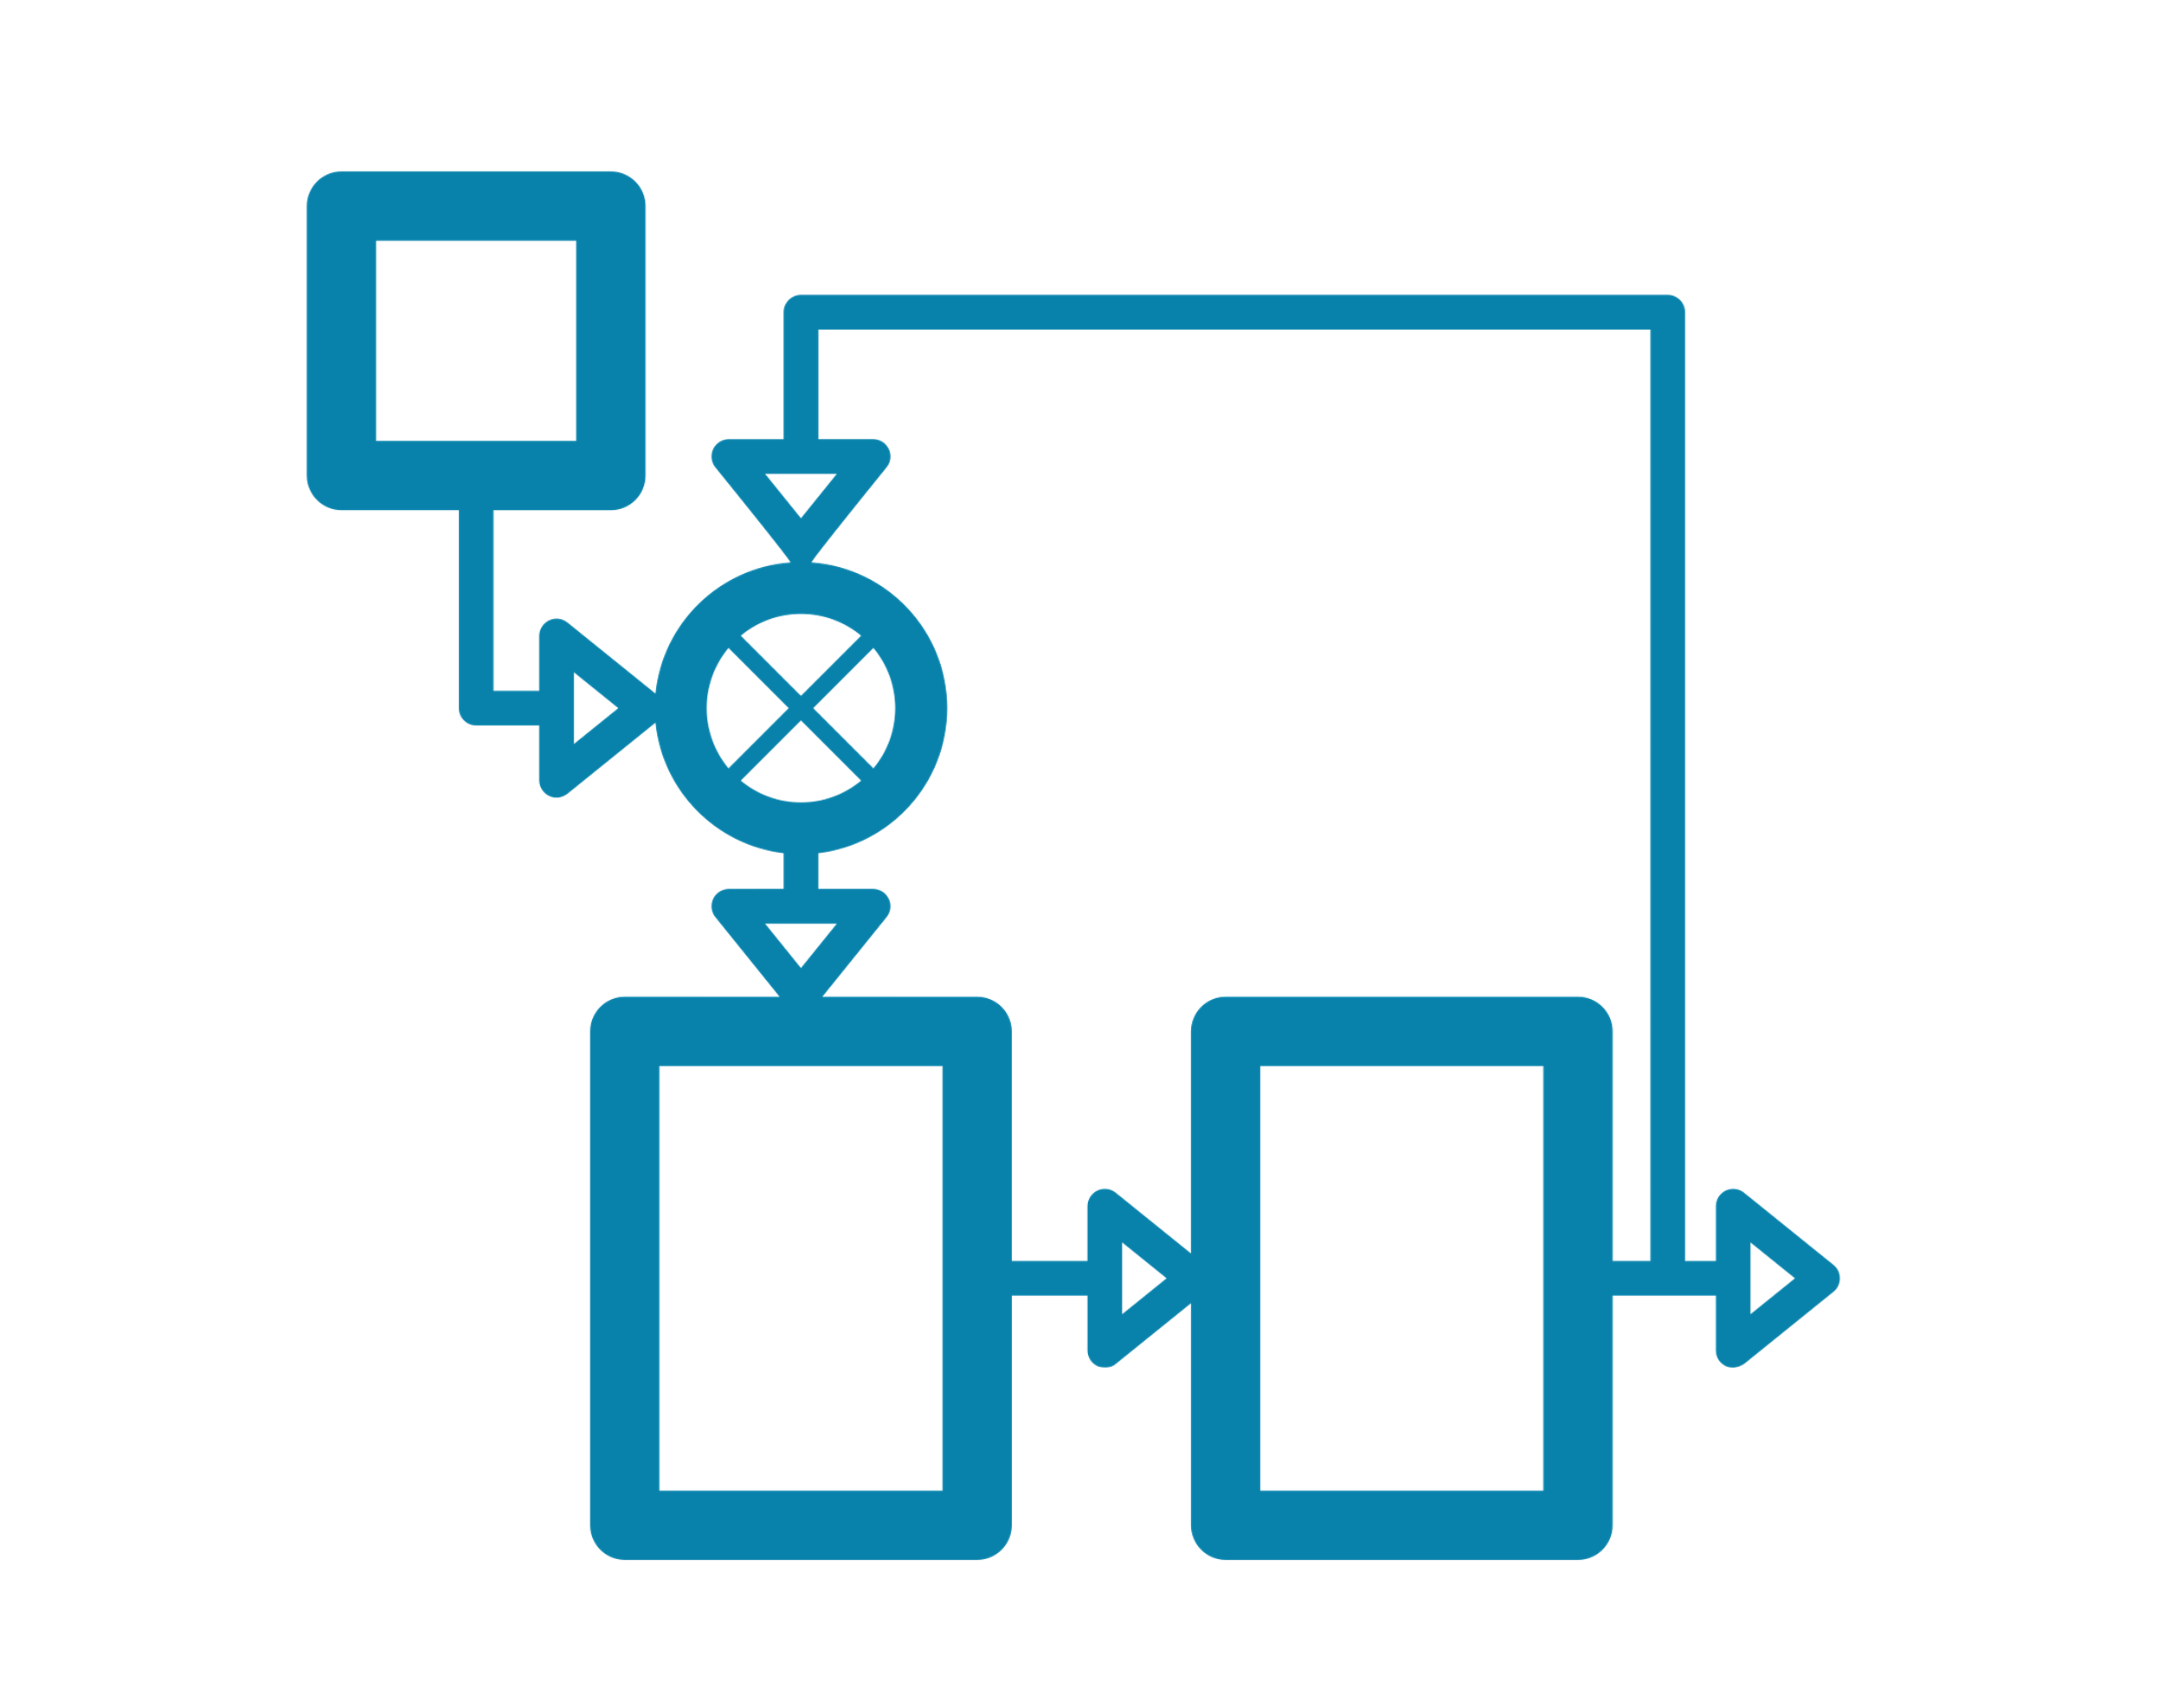
Original Study: Phylodynamic Modelling of HIV Transmission
Research Question: Is there phylogenetic evidence of assortative HIV transmission by age, race, or ethnicity among MSM in King County, Washington, USA?
Inputs
Outputs
2. Linked
De-identified Data
Demographic information (age, race, ethnicity)
CD4+ counts
date of HIV sequence sampling
3. Mathematical Model of HIV Transmission
1. Estimate a transmission probability weight for all pairs of HIV sequences
2. Aggregate probabilities to understand population-level patterns
“Black men had an X% probability of acquiring HIV from another Black man.”
“Hispanic men were Y% more likely to acquire HIV from a man of the same ethnicity.”
1. Phylogenetic Tree of HIV Sequences collected via MHS
A
B C
observed HIV sequences
Notes:
So we used a phylodynamic modeling method to see if there was any evidence of assortative HIV transmission by age or race among MSM in King County, Washington.
Our method used a phylogenetic tree created from MHS data, de-identified data on age, race, and ethnicity, and simple mathematical model as inputs.
The output of this specific method an estimated transmission probability (or a number between 0 and 1) for all directional pairs of sequences in the tree.
Individually, these probabilities cannot reliably infer direct transmission between people. However, when we aggregate them, we can describe population-level patterns.
For example, we were able to make inferences like:
Black men had an X% probability of acquiring HIV from another Black man.
Or, Hispanic men were Y% more likely to acquire HIV from a man of the same ethnicity compared to what would be expected under random transmission.

Slide 6
Why We Paused: Rapidly Evolving Discourse on MHS
Paused Study & Community
Engagement
Conducted
Analyses
NIH Grant Funded
2016
2017
2018
2019
2020
2021
NIH Ethics Working Group Convened
Ending
the HIV Epidemic Announced
NIH Ethics Recommendations Published
CDC Requires Cluster Detection & Response
HIV advocates called for a moratorium on all MHS activities
American Journal of Bioethics Issue on MHS
Increasing number of publications & presentation about community concerns related to MHS
Notes:
The parent grant to this study was funded in 2016. I joined the research group in the fall of 2018 and began to conduct analyses.
During this period, between 2017 and 2020, our study timeline paralleled a rapidly evolving discourse and concerns about MHS in public health practice.
Then in 2020, the NIH Working Group Published a new set of Ethics Recommendations, and there was a series of articles published in the American Journal of Bioethics about HIV phylogenetics in research contexts, and in particular, this series discussed concerns about the ability to infer direct transmission between individuals using MHS data.
Given the method we were using in our original study, we decided to pause the publication in response to these growing concerns and conduct community engagement

Slide 7
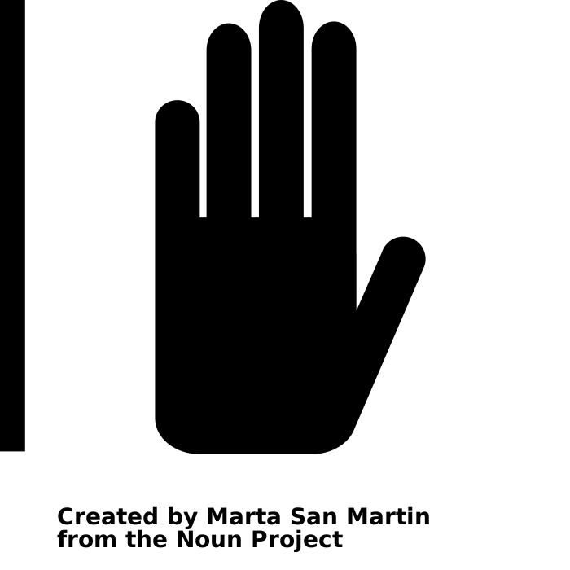
Lessons Learned Through Community Engagement
Informed Consent
Science Communication & Stigma
Directionality & Criminalization
Structural Racism & Stigma
Notes:
Our conversations with HIV advocates and community service providers revealed key themes and concerns.
We found that some community concerns about MHS in public health practice also apply to research using MHS data, namely, informed consent, communicating results, as well as directionality and criminalization
Other critiques were more specific to our research about the importance of considering the broader context of structural racism and stigma.
Today I will briefly touch on these last two points.

Slide 8
Lessons Learned Through Community Engagement
Informed Consent
Science Communication & Stigma
Directionality & Criminalization
Structural Racism & Stigma

Slide 9
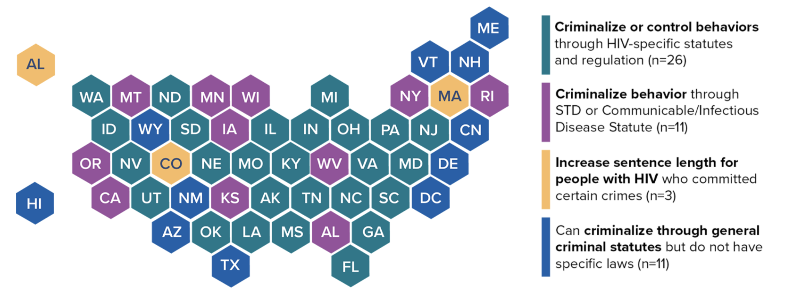
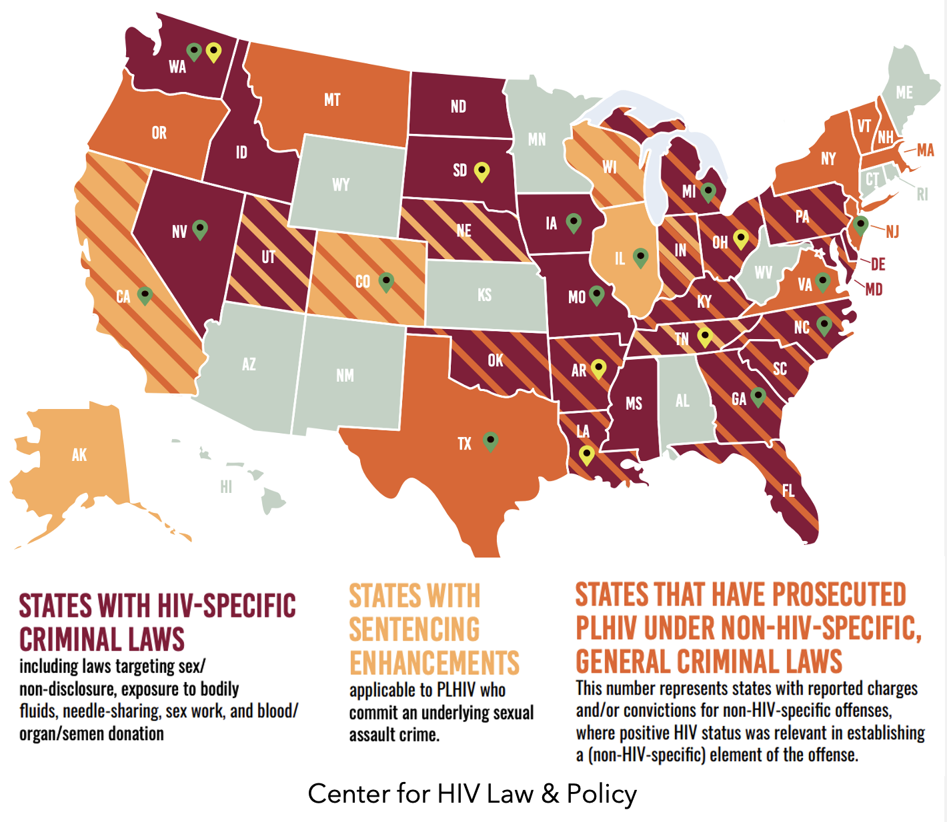
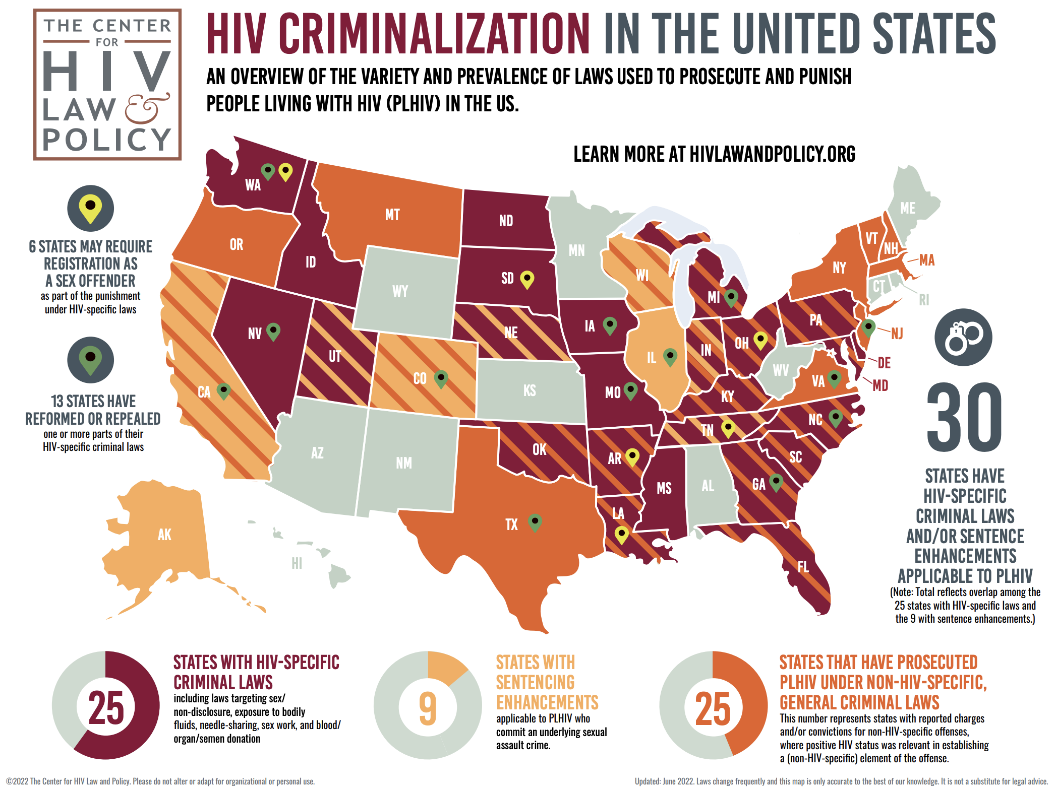
Lessons Learned Through Community Engagement
Directionality & Criminalization
HIV is criminalized in 37 US states
HIV is criminalized in over 30 states
in the US
What is directionality?
Growing concerns about the use of HIV sequences to ”prove” direct transmission
What are the implications for HIV criminalization cases?
Our method estimates a probability of transmission for all directional pairs of HIV sequences
Although these are unreliable estimates of individual transmission probabilities, can be misinterpreted to prove transmission
Data protections are perhaps not universal or consistent across localities, and importantly, are not made transparent to people living with HIV
Center for HIV Law & Policy
Center for HIV Law & Policy
Notes:
The term directionality refers to growing concerns about the ability of HIV sequences to prove direct transmission between individuals – although this is currently not possible using data from Sanger sequencing --
The potential for directionality is particularly concerning in the context of HIV criminalization.
The specific method were were applying is our study directly touched on these concerns because it estimates a probability of transmission between all HIV sequences.
Although these are unreliable estimates of individual transmission probabilities, can be misinterpreted to prove transmission
In addition, although we had access to de-identified data and a NIH Certificate of Confidentiality that protected our data from being subpoenaed
These Data protections are perhaps not universal or consistent across localities, and importantly, are not made transparent to people living with HIV

Slide 10
Lessons Learned Through Community Engagement
Structural Racism & Stigma
To community members, these types of analyses felt ‘voyeuristic’, like ‘racial profiling,’ and perpetuated harmful stereotypes
Assortative mixing is not an intervenable factor
“Assortative mixing by race/ethnicity occurs in the context of systemic oppression, and in many cases arises out of the need for in-group love and support.
Therefore, overemphasizing its role in sustaining disparities has the potential to stigmatize love, sex, pleasure, healthy coping, and partnerships within communities of people of color.”
Notes:
We also hear from community members that these types of assortativity analyses felt ‘voyeuristic’, like ‘racial profiling,’ and perpetuated harmful stereotypes
This is notable since assortativity -- they central question of our study -- is not a directly intervenable network-level characteristic
Rather, because:
Assortative mixing by race/ethnicity often occurs in the context of systemic oppression, it, in many cases arises out of the need for in-group love and support.
Therefore, overemphasizing its role in sustaining disparities has the potential to stigmatize love, sex, pleasure, healthy coping, and partnerships within communities of people of color

Slide 11
Deciding Not to Publish
Given that HIV sequences collected through MHS are obtained without informed consent for their future use in research, we felt this raised important questions…
Does this research translate into public health action and efforts to end the HIV epidemic? (Public Health Utility)
Does this research benefit—or at minimum not harm—communities of PLHIV who are included in this research without their consent? (Beneficence and nonmaleficence)
Does this research equitably distribute benefits and risks to PLHIV as well as people susceptible to acquiring HIV? (Justice)
Notes:
We felt that the two most significant harms that would result from publishing our findings included
perpetuating racialized stigma about/among MSM and
eroding the trust between phylogenetics researchers and communities of PLHIV
by choosing to publish despite their clearly and consistently articulated concerns about our original study.
We ultimately decided that these risks outweighed the benefits of publishing our original study.

Slide 12
Conclusions
HIV phylogenetics research using data collected through MHS data is a powerful scientific technology with the potential to benefit people living with HIV.
This was a challenging but transformative process.
Required us as researchers to practice cultural humility, reflexivity, self-critique, and self-reflection to unpack how our personal experiences, identities, and positions as researchers contributed to our blind spots.
Due to significant concerns rooted in consent, criminalization, and stigma, communities should be empowered to set priorities for why, how, and when to do such analysis.
Notes:
This was a challenging process that required us as researchers to practice reflexivity and unpack how our personal experiences and positions as researchers contributed to our blind spots.
We DO believe that HIV phylogenetics is a powerful scientific technology with the potential to benefit people living with HIV
But Due to significant concerns rooted in consent, criminalization, and stigma, communities should be empowered to set priorities for why, how, and when to do such analysis.

Slide 13
Opportunities for Advocacy by Researchers
Advocate for Structural Interventions | Decriminalization of HIV, sex work, and drug use. Policies that prohibit the use of MHS data in criminal, civil or immigration investigations or prosecutions. Provide expert testimony in HIV criminal cases and educate courts, judges, and lawyers about the limitations of HIV sequence analyses and their inability to reliably infer direct transmission.
Promote Autonomy | Develop partnerships, community advisory boards, and power-sharing mechanisms with networks of PLHIV to facilitate ongoing community engagement. Apply implementation science and community-based participatory research methods to understand the feasibility of and barriers to collecting informed consent as well as the acceptability of alternative methods that promote data justice (e.g., opt-out systems, data ownership models, etc.).
Promote Transparency | Support local, state, and national public health agencies to increase transparency about how MHS data are used. Evaluate the effectiveness of cluster detection and response
Bridge Understanding | Pause research to conduct in-depth community engagement to determine how to conduct research using data collected through MHS in a way that is acceptable. Facilitate community engagement and restorative justice between community members and public health agencies to bridge understanding/build trust for the use of MHS data. Qualitative studies to understand the experiences and perspectives of PLHIV who have been contacted as a result of cluster detection and response investigations.
Notes:
There are numerous opportunities for researchers to advocate for structural interventions, promote autonomy and transparency, and to bridge understanding between researchers, public health and people living with HIV.
For example:
HIV phylogenetics researchers need to be equally committed to the decriminalization of HIV, sex work and drug use
Researchers are also well poised to develop power sharing mechanism and ongoing community engagement
as well as methods that promote data justice, like the collection informed consent, opt-out systems, or data ownership models.

Slide 14
Opportunities for Advocacy by Researchers
Advocate for Structural Interventions | Decriminalization of HIV, sex work, and drug use. Policies that prohibit the use of MHS data in criminal, civil or immigration investigations or prosecutions. Provide expert testimony in HIV criminal cases and educate courts, judges, and lawyers about the limitations of HIV sequence analyses and their inability to reliably infer direct transmission.
Promote Autonomy | Develop partnerships, community advisory boards, and power-sharing mechanisms with networks of PLHIV to facilitate ongoing community engagement. Apply implementation science and community-based participatory research methods to understand the feasibility of and barriers to collecting informed consent as well as the acceptability of alternative methods that promote data justice (e.g., opt-out systems, data ownership models, etc.).
Promote Transparency | Support local, state, and national public health agencies to increase transparency about how MHS data are used. Evaluate the effectiveness of cluster detection and response
Bridge Understanding | Pause research to conduct in-depth community engagement to determine how to conduct research using data collected through MHS in a way that is acceptable. Facilitate community engagement and restorative justice between community members and public health agencies to bridge understanding/build trust for the use of MHS data. Qualitative studies to understand the experiences and perspectives of PLHIV who have been contacted as a result of cluster detection and response investigations.
Notes:
There are numerous opportunities for researchers to advocate for structural interventions, promote autonomy and transparency, and to bridge understanding between researchers, public health and people living with HIV.
For example:
HIV phylogenetics researchers need to be equally committed to the decriminalization of HIV, sex work and drug use
Researchers are also well poised to develop power sharing mechanism and ongoing community engagement
as well as methods that promote data justice, like the collection informed consent, opt-out systems, or data ownership models.

Slide 15
Opportunities for Advocacy by Researchers
Advocate for Structural Interventions | Decriminalization of HIV, sex work, and drug use. Policies that prohibit the use of MHS data in criminal, civil or immigration investigations or prosecutions. Provide expert testimony in HIV criminal cases and educate courts, judges, and lawyers about the limitations of HIV sequence analyses and their inability to reliably infer direct transmission.
Promote Autonomy | Develop partnerships, community advisory boards, and power-sharing mechanisms with networks of PLHIV to facilitate ongoing community engagement. Apply implementation science and community-based participatory research methods to understand the feasibility of and barriers to collecting informed consent as well as the acceptability of alternative methods that promote data justice (e.g., opt-out systems, data ownership models, etc.).
Promote Transparency | Support local, state, and national public health agencies to increase transparency about how MHS data are used. Evaluate the effectiveness of cluster detection and response
Bridge Understanding | Pause research to conduct in-depth community engagement to determine how to conduct research using data collected through MHS in a way that is acceptable. Facilitate community engagement and restorative justice between community members and public health agencies to bridge understanding/build trust for the use of MHS data. Qualitative studies to understand the experiences and perspectives of PLHIV who have been contacted as a result of cluster detection and response investigations.
Notes:
There are numerous opportunities for researchers to advocate for structural interventions, promote autonomy and transparency, and to bridge understanding between researchers, public health and people living with HIV.
For example:
HIV phylogenetics researchers need to be equally committed to the decriminalization of HIV, sex work and drug use
Researchers are also well poised to develop power sharing mechanism and ongoing community engagement
as well as methods that promote data justice, like the collection informed consent, opt-out systems, or data ownership models.

Slide 16
Opportunities for Advocacy by Researchers
Advocate for Structural Interventions | Decriminalization of HIV, sex work, and drug use. Policies that prohibit the use of MHS data in criminal, civil or immigration investigations or prosecutions. Provide expert testimony in HIV criminal cases and educate courts, judges, and lawyers about the limitations of HIV sequence analyses and their inability to reliably infer direct transmission.
Promote Autonomy | Develop partnerships, community advisory boards, and power-sharing mechanisms with networks of PLHIV to facilitate ongoing community engagement. Apply implementation science and community-based participatory research methods to understand the feasibility of and barriers to collecting informed consent as well as the acceptability of alternative methods that promote data justice (e.g., opt-out systems, data ownership models, etc.).
Promote Transparency | Support local, state, and national public health agencies to increase transparency about how MHS data are used. Evaluate the effectiveness of cluster detection and response
Bridge Understanding | Pause research to conduct in-depth community engagement to determine how to conduct research using data collected through MHS in a way that is acceptable. Facilitate community engagement and restorative justice between community members and public health agencies to bridge understanding/build trust for the use of MHS data. Qualitative studies to understand the experiences and perspectives of PLHIV who have been contacted as a result of cluster detection and response investigations.
Notes:
There are numerous opportunities for researchers to advocate for structural interventions, promote autonomy and transparency, and to bridge understanding between researchers, public health and people living with HIV.
For example:
HIV phylogenetics researchers need to be equally committed to the decriminalization of HIV, sex work and drug use
Researchers are also well poised to develop power sharing mechanism and ongoing community engagement
as well as methods that promote data justice, like the collection informed consent, opt-out systems, or data ownership models.

Slide 17
Thank you!
Coauthors, Brian Minalga, Alfredo Trejo, Alic Shook, Roxanne P. Kerani, Joshua T. Herbeck
Stephaun Wallace and the Community Engagement Office with the University of Washington/Fred Hutch Center for AIDS Research (CFAR).
Community Coalition on Molecular HIV Surveillance, including Alexander McClelland, Andrew Spieldenner, Ronald Johnson, Marco Castro-Bojorquez, and Edwin Bernard.
Positive Women’s Network USA, including Naina Khanna, Victoria Siciliano, and Kelly Flannery.
Everyone who contributed to our community engagement process, including the attendees of the Public Health—Seattle & King County Lunchbox Talk, Salon Presentation, and its organizers, Susan Buskin and Jsani Henry.
This work was funded by the NIH NIAID (R01AI127232).
Pre-Print of
our Paper is Available at:
bit.ly/LESSONS-
LEARNED-TORDOFF
Notes:
If you would like to learn more about our experience, a pre-print of our paper is available.
I’d like to thank all of my incredible collaborators and coauthors, As well as everyone who participated in our community engagement process, including the community coalition of MHS, and the positive womens network
Thank you for your time and attention.

