Slide 1
Inequalities in the HIV response faced by key populations
Midnight Poonkasetwattana, Executive Director, APCOM
Quest to Reach Epidemic Control

Slide 2
About
APCOM wants a world where SOGIESC people can fully participate in and achieve sustainable development in all aspects of their health, rights and wellbeing.
-----
APCOM is in the process of developing a new strategy which will build upon our strategic framework:
-----
Our work centers on:
HIV is not over:
Strengthening the HIV response
Our Rights:
Protecting and promoting the human rights of our communities
Our Strength:
Stronger interlinked communities and broader partner networks
Covid-19:
And the effect of Covid-19 on our communities and movement
1)
Education & Innovation
2)
Research & Advocacy
3)
Community Engagement & Empowerment

Slide 3
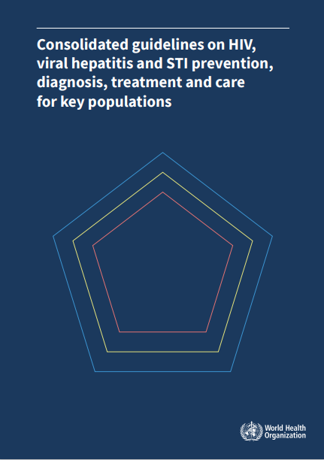
Who are the Key populations?
The World Health Organization (WHO), through Consolidated Guidelines on Key Populations, identified men who have sex with men, people who inject drugs, sex workers, trans and gender diverse persons, and people in prisons and other closed settings.
The ‘key population’ are the defined groups who, due to specific higher-risk behaviors, are at increased risk of HIV or STIs.
They often have legal and social issues related to their behaviors that increase their vulnerability to HIV. The engagement with and of key population is critical to a successful HIV response.

Slide 4
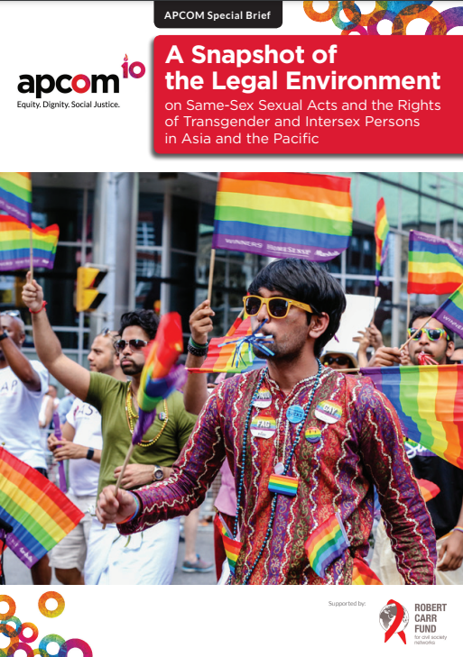
Inequality: Legal and Structural
In 2016, APCOM produced a Snapshot of the Legal Environment in Asia and the Pacific
The Snapshot provides an overview of the legal environments in the Asia-Pacific region to inform the issues, challenges and opportunities regarding the rights of men who have sex with men and women who have sex with women, as well as transgender and intersex persons
Male and/or female same-sex sexual activity is criminalised in 12 States, or part of States, in Asia (Afghanistan, Bangladesh, Bhutan, Brunei Darussalam, India, South Sumatra and Aceh Provinces of Indonesia, Malaysia, Maldives, Myanmar, Pakistan, Singapore and Sri Lanka) and in seven States in the Pacifc (Cook Islands, Kiribati, Papua New Guinea, Samoa, Solomon Islands, Tonga and Tuvalu).

Slide 5
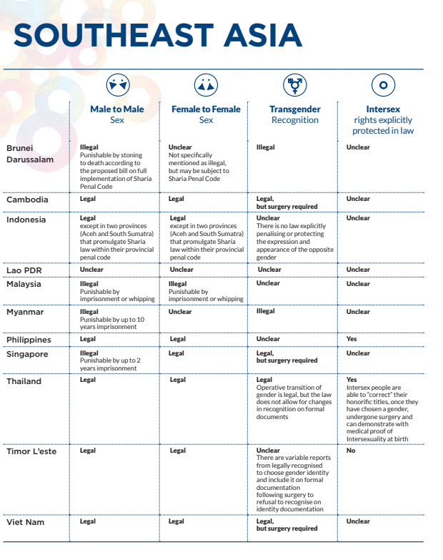
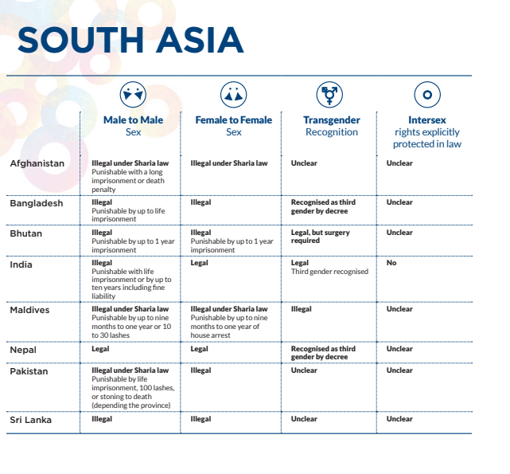

Slide 6
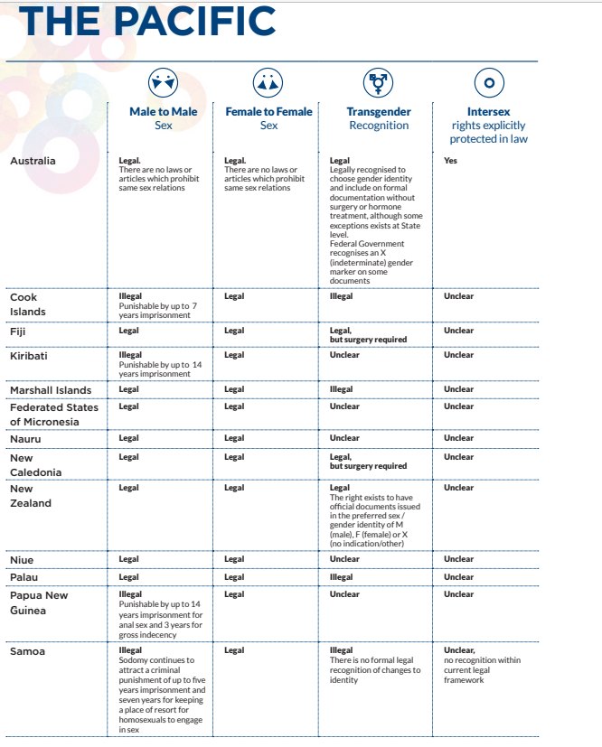
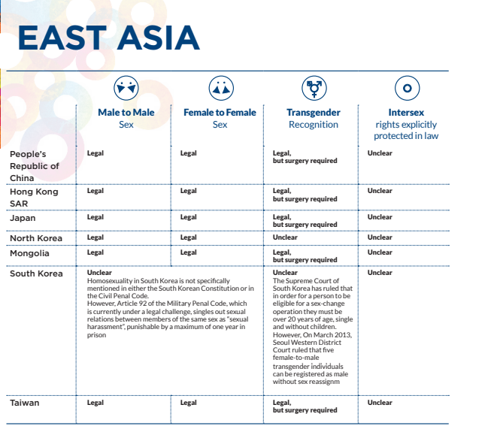

Slide 7
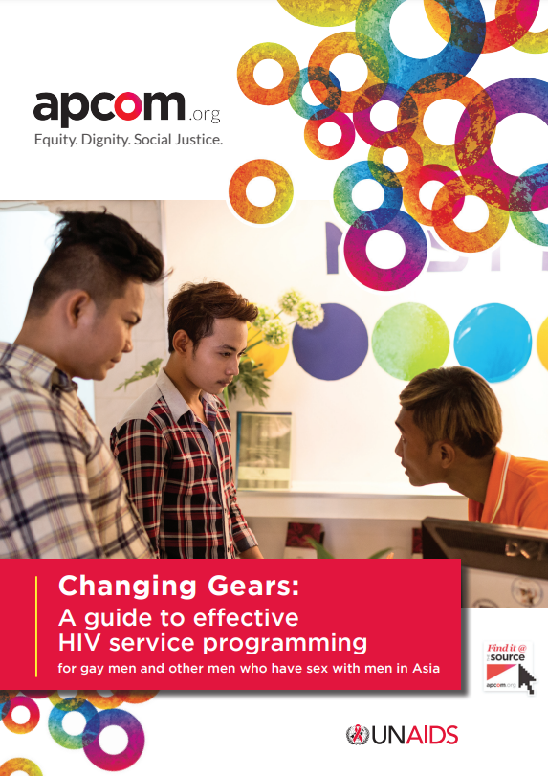
Inequality: Access to HIV Services
Key population often face (or fear they will face) discrimination and stigma at the hands of health care providers, resulting in their being hesitant to access services.
For young key population, there is the issue of self-stigma that leads them to not access the services they need.
Services remain to be not respond to the needs and concerns of key population. In some cases, services or public health care facilities are not friendly (or worse, hostile) towards key population.
These are exacerbated by the COVID-19 pandemic where access to services become more challenging.
Source

Slide 8
Inequality: COVID-19 Pandemic
During these times where operations are interrupted, it is certain that members of the community are not accessing health services. In Pakistan, there are already cases of stock-outs of ARVs and unavailability of HIV services even before the COVID-19 outbreak.
The COVID-19 pandemic also affects the economic stability of the key population, LGBTQI and SOGIESC communities.
the salaries of outreach workers and staff of community based organisations are also dependent on the operations of HIV services. In the absence of activities and during office closures, the staff are unsure about their salaries.
Livelihood of the key population, SOGIESC people, and some staff of community-based organisations are placed vulnerable situations. Their ability to feed, maintain their accommodation and pay for basic necessities have significantly affected by the lockdown, restrictions to mobility and closures of establishments.

Slide 9
Inequality: Justice and human rights mechanism
Criminalisation of key population and PLHIV largely contributes to ineffective access to justice system. The letters of the law automatically labels KP or PLHIV as a criminal, and leads to difficulty in accessing legal support.
Unaddressed stigma and discrimination within the system, aggravated by criminalisation, may result to unjust detention and threat to personal security of key population or PLHIV.
This deters the progresses made by International development agencies, health sector and non-government community-based organisations in widening HIV testing outreach to ensure that newly diagnosed PLHIVs have timley access to treatment.
To protect the rights and uphold the dignity of PLHIVs, we aim to reduce HIV-related stigma and discrimination in the justice sector.

Slide 10
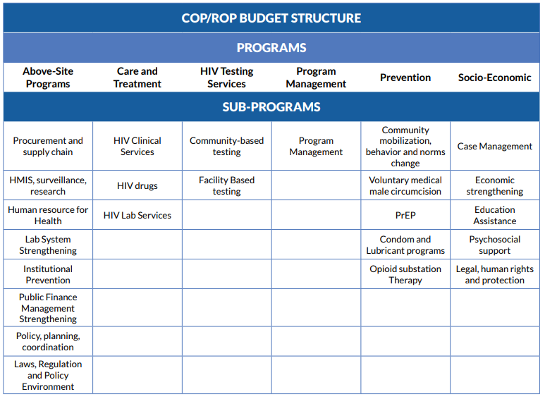
Inequality: Investments towards KP-led organizations
PEPFAR
The Country Operational Plans / Regional Operational Plans 2022 (COP/ROP22) operate through progressive language and highlight the inclusion of programs and activities that are community-focused, community-led and services that are community-delivered.
In order for key population and their networks to effectively participate in the development of their respective countries’ Country Operational Plan, more detailed knowledge on investments is required.
The data needed are the amount of funding from a country’s COP/ROP21 budget which was allocated to key population programs.
In scanning the budget, we were guided by the PEPFAR COP/ROP22 budget structure. This knowledge tool will help key population understand and navigate the amount of funding that is allocated to the KP services at the country level.

Slide 11
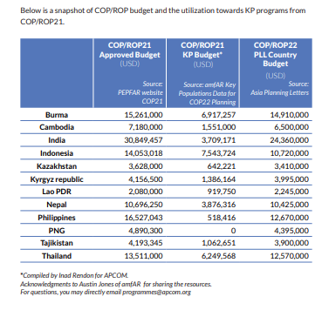
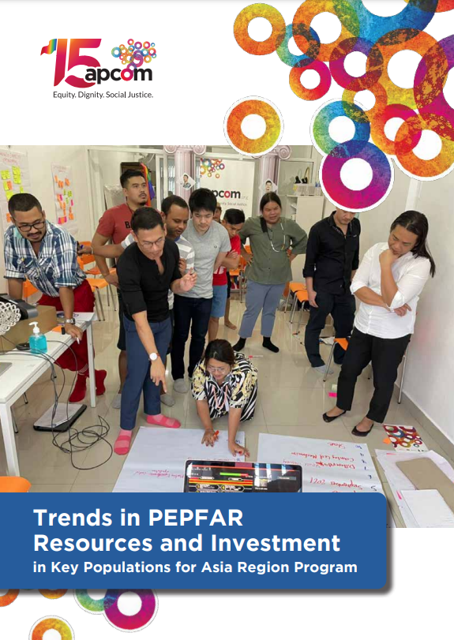
Inequality: Investments towards KP-led organizations
However, in contrast to PEPFAR’s progressive language and inclusive strategy in COP/ROP22, investments in Asian countries are flatlining or continuously decreasing.
The following data are estimate COP/ROP budget approved and spent of Asian countries during COP/ROP21, and their allocated budget for COP/ROP22.
The data also presents the amount of funding from a country’s COP/ROP21 budget which was allocated to key population programs.

Slide 12
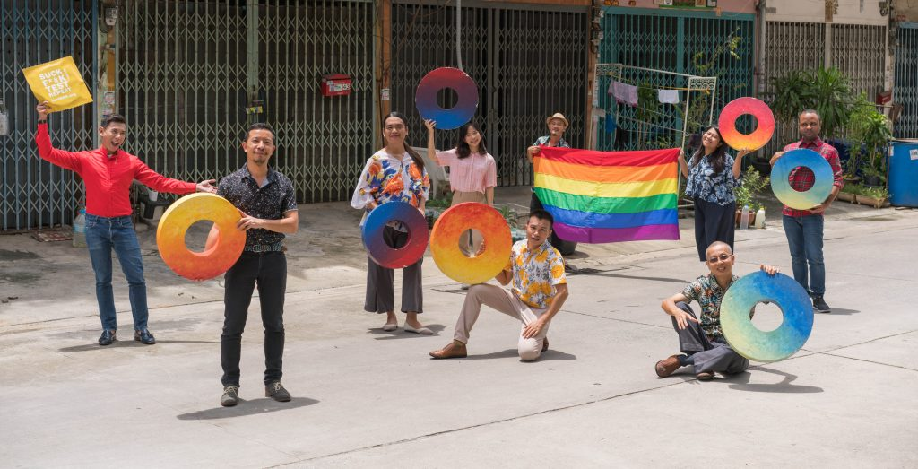
THANK YOU!

