Slide 1
Global epidemiology and actions for prioritizing access and scale up of HIV prevention and treatment programmes
Eamonn Murphy
Deputy Executive Director,
UNAIDS, Geneva

Slide 2
Governments committed to 25 targets within the Political Declaration
Prevent and treatment were two of those targets
Gender equity, human rights, community leadership and integration and investments were also targets

Slide 3
Progress towards the 2025 targets

Slide 4
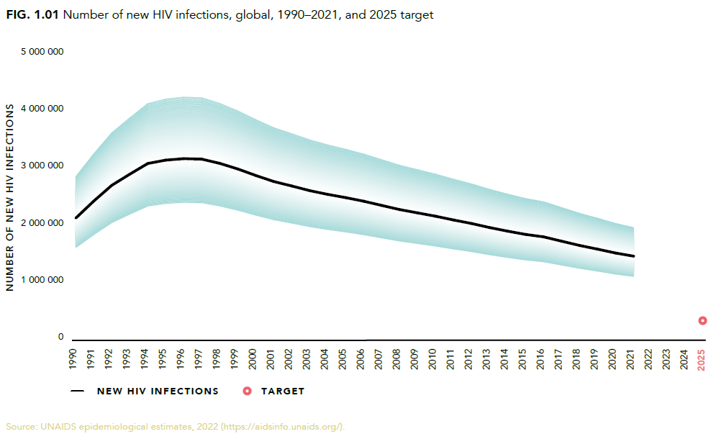
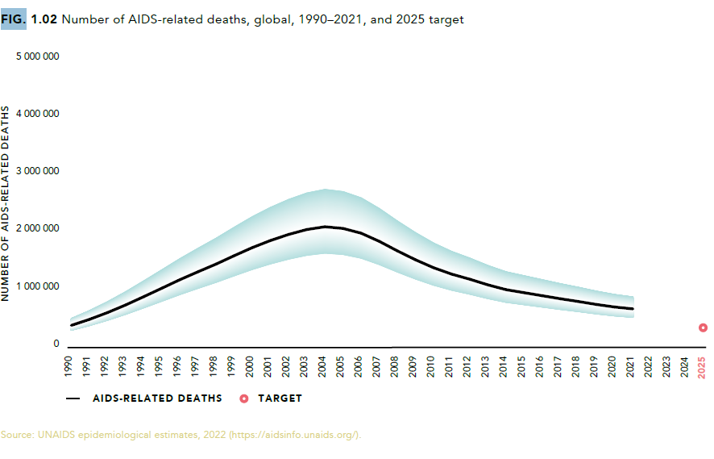
Epidemiologic targets
Decline in number of new HIV infections has stagnated. We will miss the 2025 target unless treatment coverage is accelerated and effective prevention efforts re-invigorated and barriers to inclusion are removed.
2021 new HIV infections
1 500 000 [1 100 000–2 000 000]
2021 AIDS-related deaths
650 000 [510 000–860 000]
Notes:
There are 26 targets reported in the targets chapter, some of which have subtargets reported.

Slide 5
31 countries achieved epidemic transition in 2021, many in the highest burdened region of Eastern Southern Africa
Using the incidence prevalence metric, the following countries have achieved epidemic transition by 2021
Asia and the Pacific |  | Caribbean |  | Eastern Europe and Central Asia |  | Eastern and Southern Africa |  | Middle East and North Africa |  | Western and Central Africa |  | Western Europe and North America
Australia |  | Haiti |  | Azerbaijan |  | Botswana |  | Djibouti |  | Benin |  | Denmark
Cambodia |  |  |  | Ukraine |  | Eritrea |  |  |  | Burkina Faso |  | Italy
India |  |  |  |  |  | Ethiopia |  |  |  | Burundi |  | Netherlands
New Zealand |  |  |  |  |  | Kenya |  |  |  | Cameroon |  | Portugal
Thailand |  |  |  |  |  | Lesotho |  |  |  | Cote dIvoire |  | Spain
Viet Nam |  |  |  |  |  | Malawi |  |  |  | Togo
 |  |  |  |  |  | Rwanda
 |  |  |  |  |  | South Africa
 |  |  |  |  |  | Zambia
 |  |  |  |  |  | Zimbabwe
For a full explanation of epidemic transition metrics see Ghys et al. 2018. Epidemiological metrics and benchmarks for
a transition in the HIV epidemic Plos Med.

Slide 6
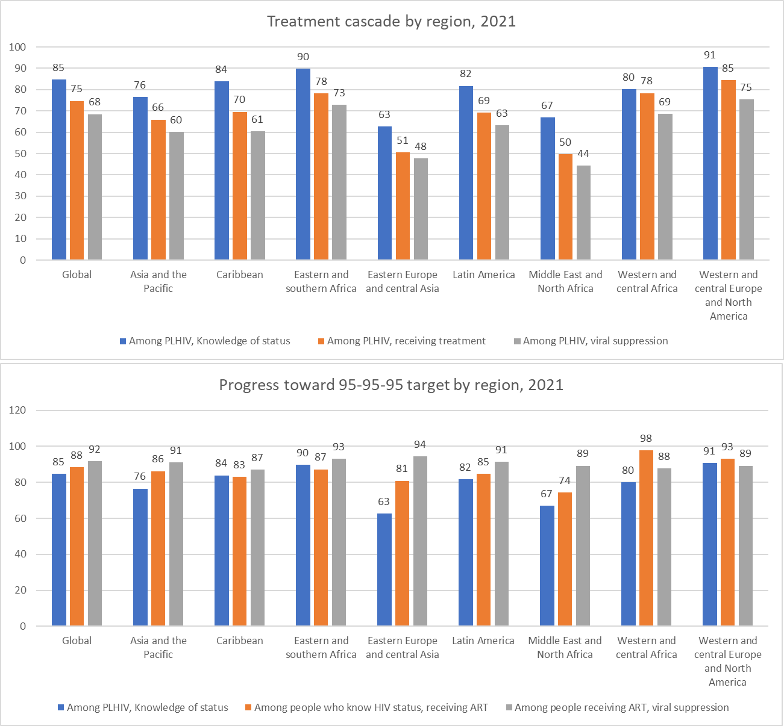
Variation in testing and treatment cascade across regions
No region has achieved the 95-95-95 targets or the 90-90-90
The indicator with the largest variation is knowledge of status
63% in EECA and 91% in WCENA
Children remain far behind adults with 52% of children living with HIV on treatment compared to 76% among adults

Slide 7
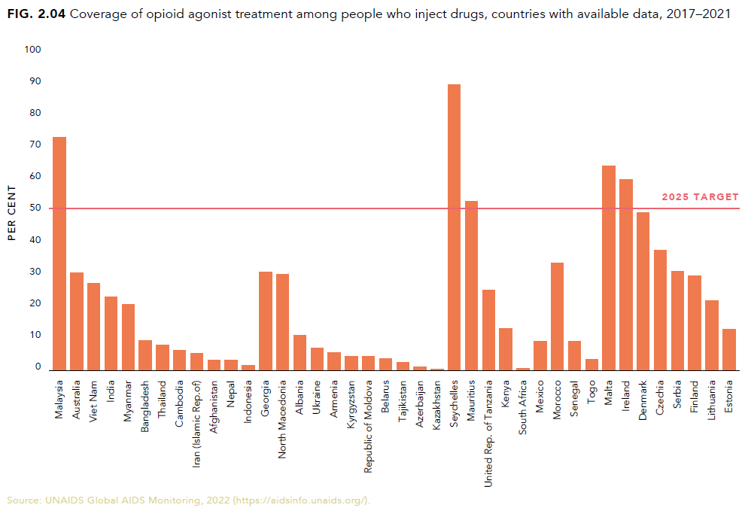
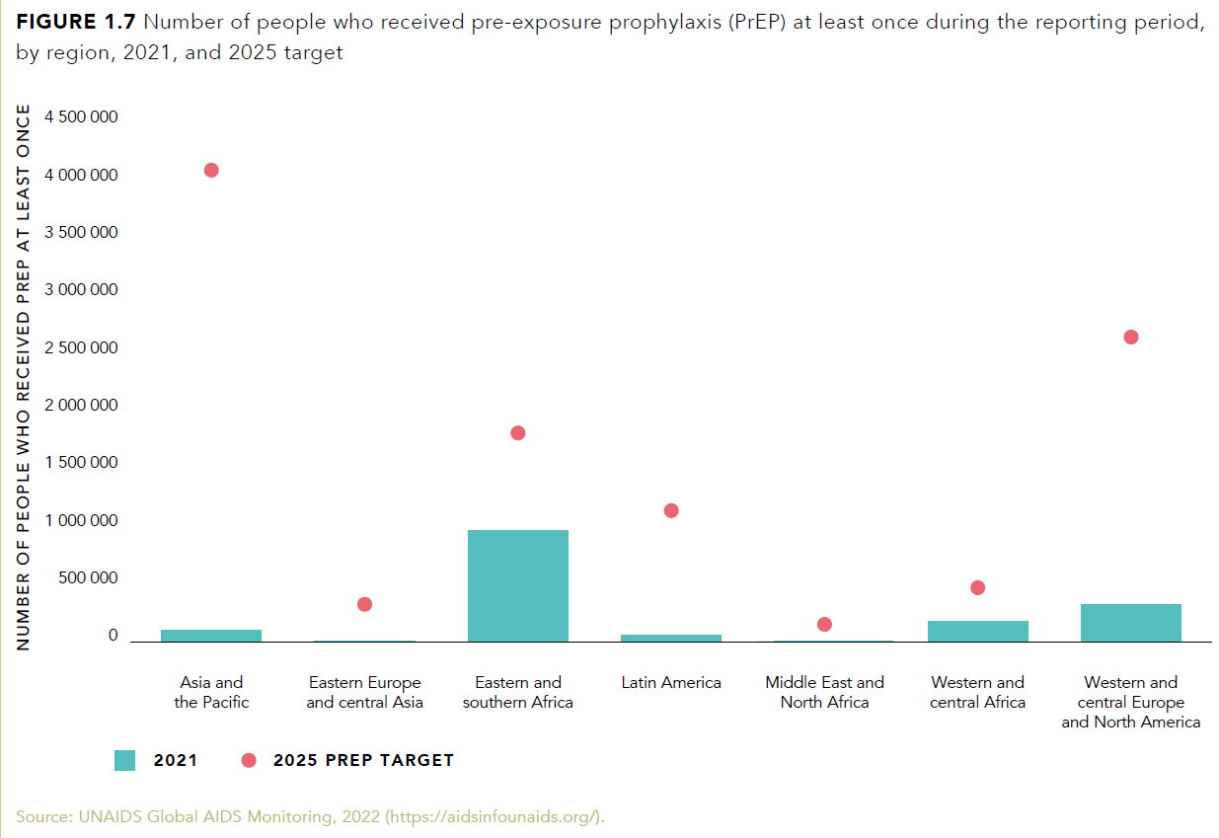
Opioid agonist treatment is still not universally adopted and, when it is available, is often taken up at levels well below the 2025 targets. We do see that 5 countries have reached the target already and a few are close.
Prevention targets
Although there was significant scale up of PrEP in eastern and southern Africa, we are still far behind the regional targets and global target of 11 million by 2025.

Slide 8
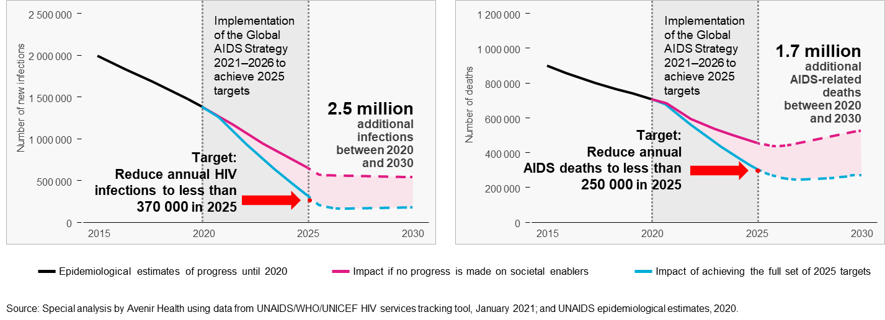
However, we will not reach epidemic transition
without a focus on societal enablers and
community engagement 30-80-60

Slide 9
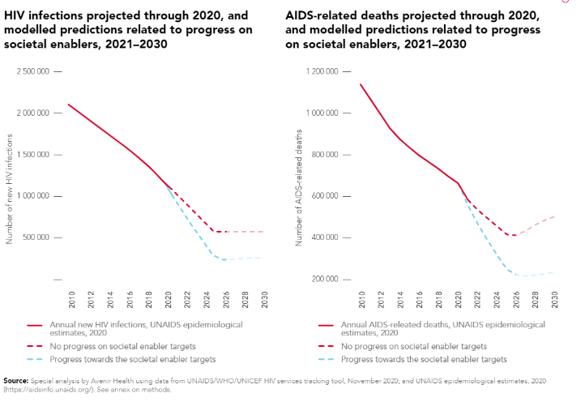
Societal enablers needed to reach impact goals
Failure to make any progress on societal enablers would undermine efforts to reach the HIV service targets, resulting in an additional 1.7 million AIDS-related deaths and 2.5 million additional new HIV infections between 2021 and 2030.
Notes:
One analysis focused on available studies that have quantitatively measured the negative impact that stigma and discrimination and the criminalization of sex work, drug use and same-sex sexual relationships would have on HIV prevention, testing and treatment efforts.
The analysis suggests that failure to make any progress on HIV-related stigma and discrimination
would undermine efforts to reach the HIV testing, treatment and viral suppression targets, resulting
in an additional 440 000 AIDS-related deaths between 2020 and 2030, and that failure to make any progress across all societal enablers would undermine efforts to reach HIV prevention targets, resulting in 2.6 million additional new HIV infections over the same period.

Slide 10
Commitments to reaching global targets
30% of testing and treatment services to be delivered by community-led organizations.
80% of service delivery for HIV prevention programmes for key populations and of services for women to be delivered by community-led, key population-led, and women-led organizations respectively.
60% of the programmes supporting the achievement of societal enablers to be delivered by community-led organizations.

Slide 11
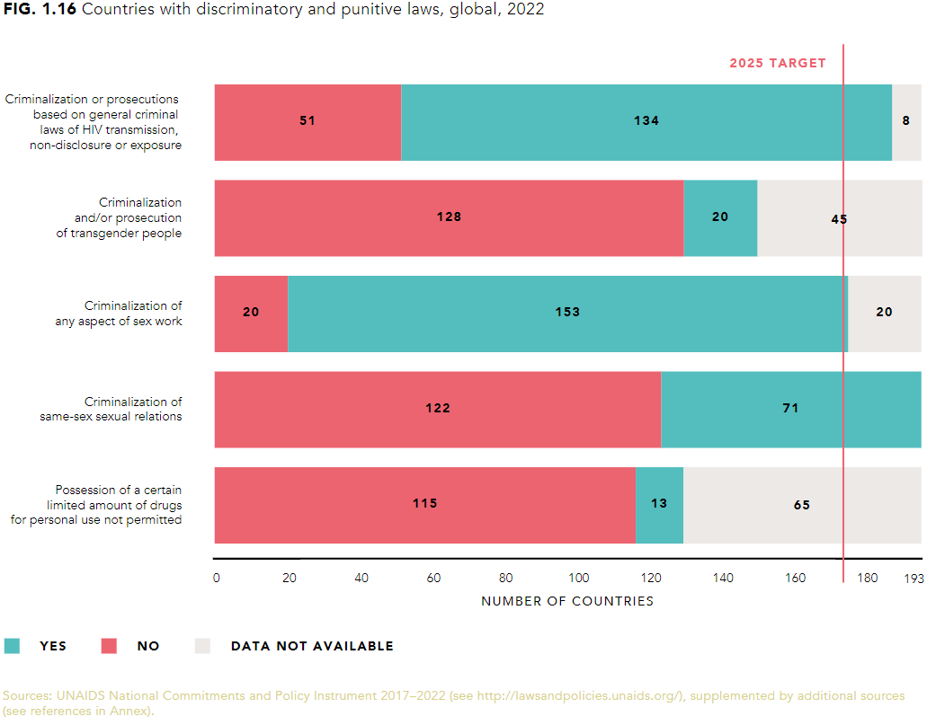
Law reform is happening but is still too slow
A number of countries decriminalized HIV risk behviours in 2021
Sex work: Victoria (Australia) and Belgium
HIV exposure / non-disclosure and transmission: Zimbabwe, Armenia, various US states*
Same-sex sexual activity: Antigua & Barbuda
Possession of drugs for personal use: ACT (Australia), Thailand (marijuana only), BC (Canada) granted an exemption to decriminalise.
India's Supreme Court recently issued directives to government to implement human rights obligations relating to sex workers and the right to dignity at work.
*in some cases laws were not repealed but their scope was narrowed.
Notes:
Human rights generally but also the targets and progress around gender....women's rights as human rights
As part of our monitoring work we also take a deep dive into some of the law reform through case studies in the report.

Slide 12
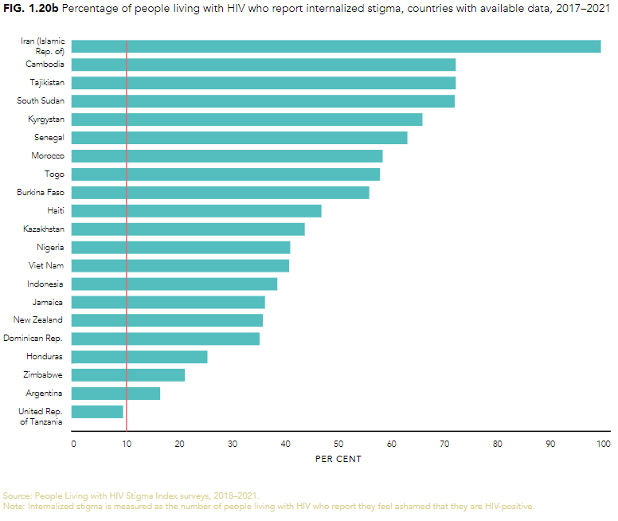
Stigma and discrimination still blocks the way forward
In nine of 21 countries, more than half of people living with HIV surveyed reported feeling ashamed of having HIV.
Experience of stigma in health and community settings is slightly better: 6/23 in health care, 5/18 in community met the target of <10%.
We are seeing increased action on stigma and discrimination, but more needs to be done.
30 countries have joined the Global Partnership for Action to Eliminate all forms of HIV-related Stigma and Discrimination
19 countries are accelerating stigma and discrimination reduction in priority settings.
Eighteen have also introduced legal reforms and/or increased access to justice for key populations in the past three years.
Notes:
We heard earlier about the high prevalence of discriminatory attitudes.
Target that 10% of people living with HIV report internalised stigma. The data we have from the past 4 years indicates we have a long way to go. Only one country is meeting the target.
For example, in the Central African Republic, the ministries of health and justice are working with parliamentarians to decriminalize HIV transmission, better protect the human rights of people living with HIV and key populations, and lower the age of consent for HIV testing. Similarly, the Islamic Republic of Iran promulgated its first-ever antidiscrimination regulation in health-care settings at the end of 2020, which requires that both public and private health-care facilities protect people living with HIV and key populations from stigma and discrimination.

Slide 13
Key actions to reach epidemic transition and get the HIV response on track to end AIDS by 2030
A new push for HIV prevention: more extensive and equitable prevention programmes are needed. Rebooting condom programmes, getting the most out of ARV-based interventions, including the scale up of PrEP, and increasing coverage of VMMC programmes in priority countries.
Realize human rights and gender equality: countries must take action to meet broader human rights obligations and reduce the underlying inequalities and intersecting forms of discrimination that hold back progress.
Support and effectively resource community-led responses: new policies, guidance, and models are needed for the scale-up of integrated community-led responses and more consistent and easily accessible funding and capacity building support should be made available to enable women and young people in all their diversity to assume leadership roles.
Ensure sufficient and sustainable financing: crucial importance of equitable and efficient public health systems, of adequate and well-protected health workforces, and of affordable health services and products everywhere.
Ending AIDS will require political courage.
Notes:
To wrap up – the thematic chapters of the report will focus on the key actions:
Address inequalities in HIV prevention, testing and treatment access and outcomes and close the gaps that exist in specific groups and localities.

